Slide 1
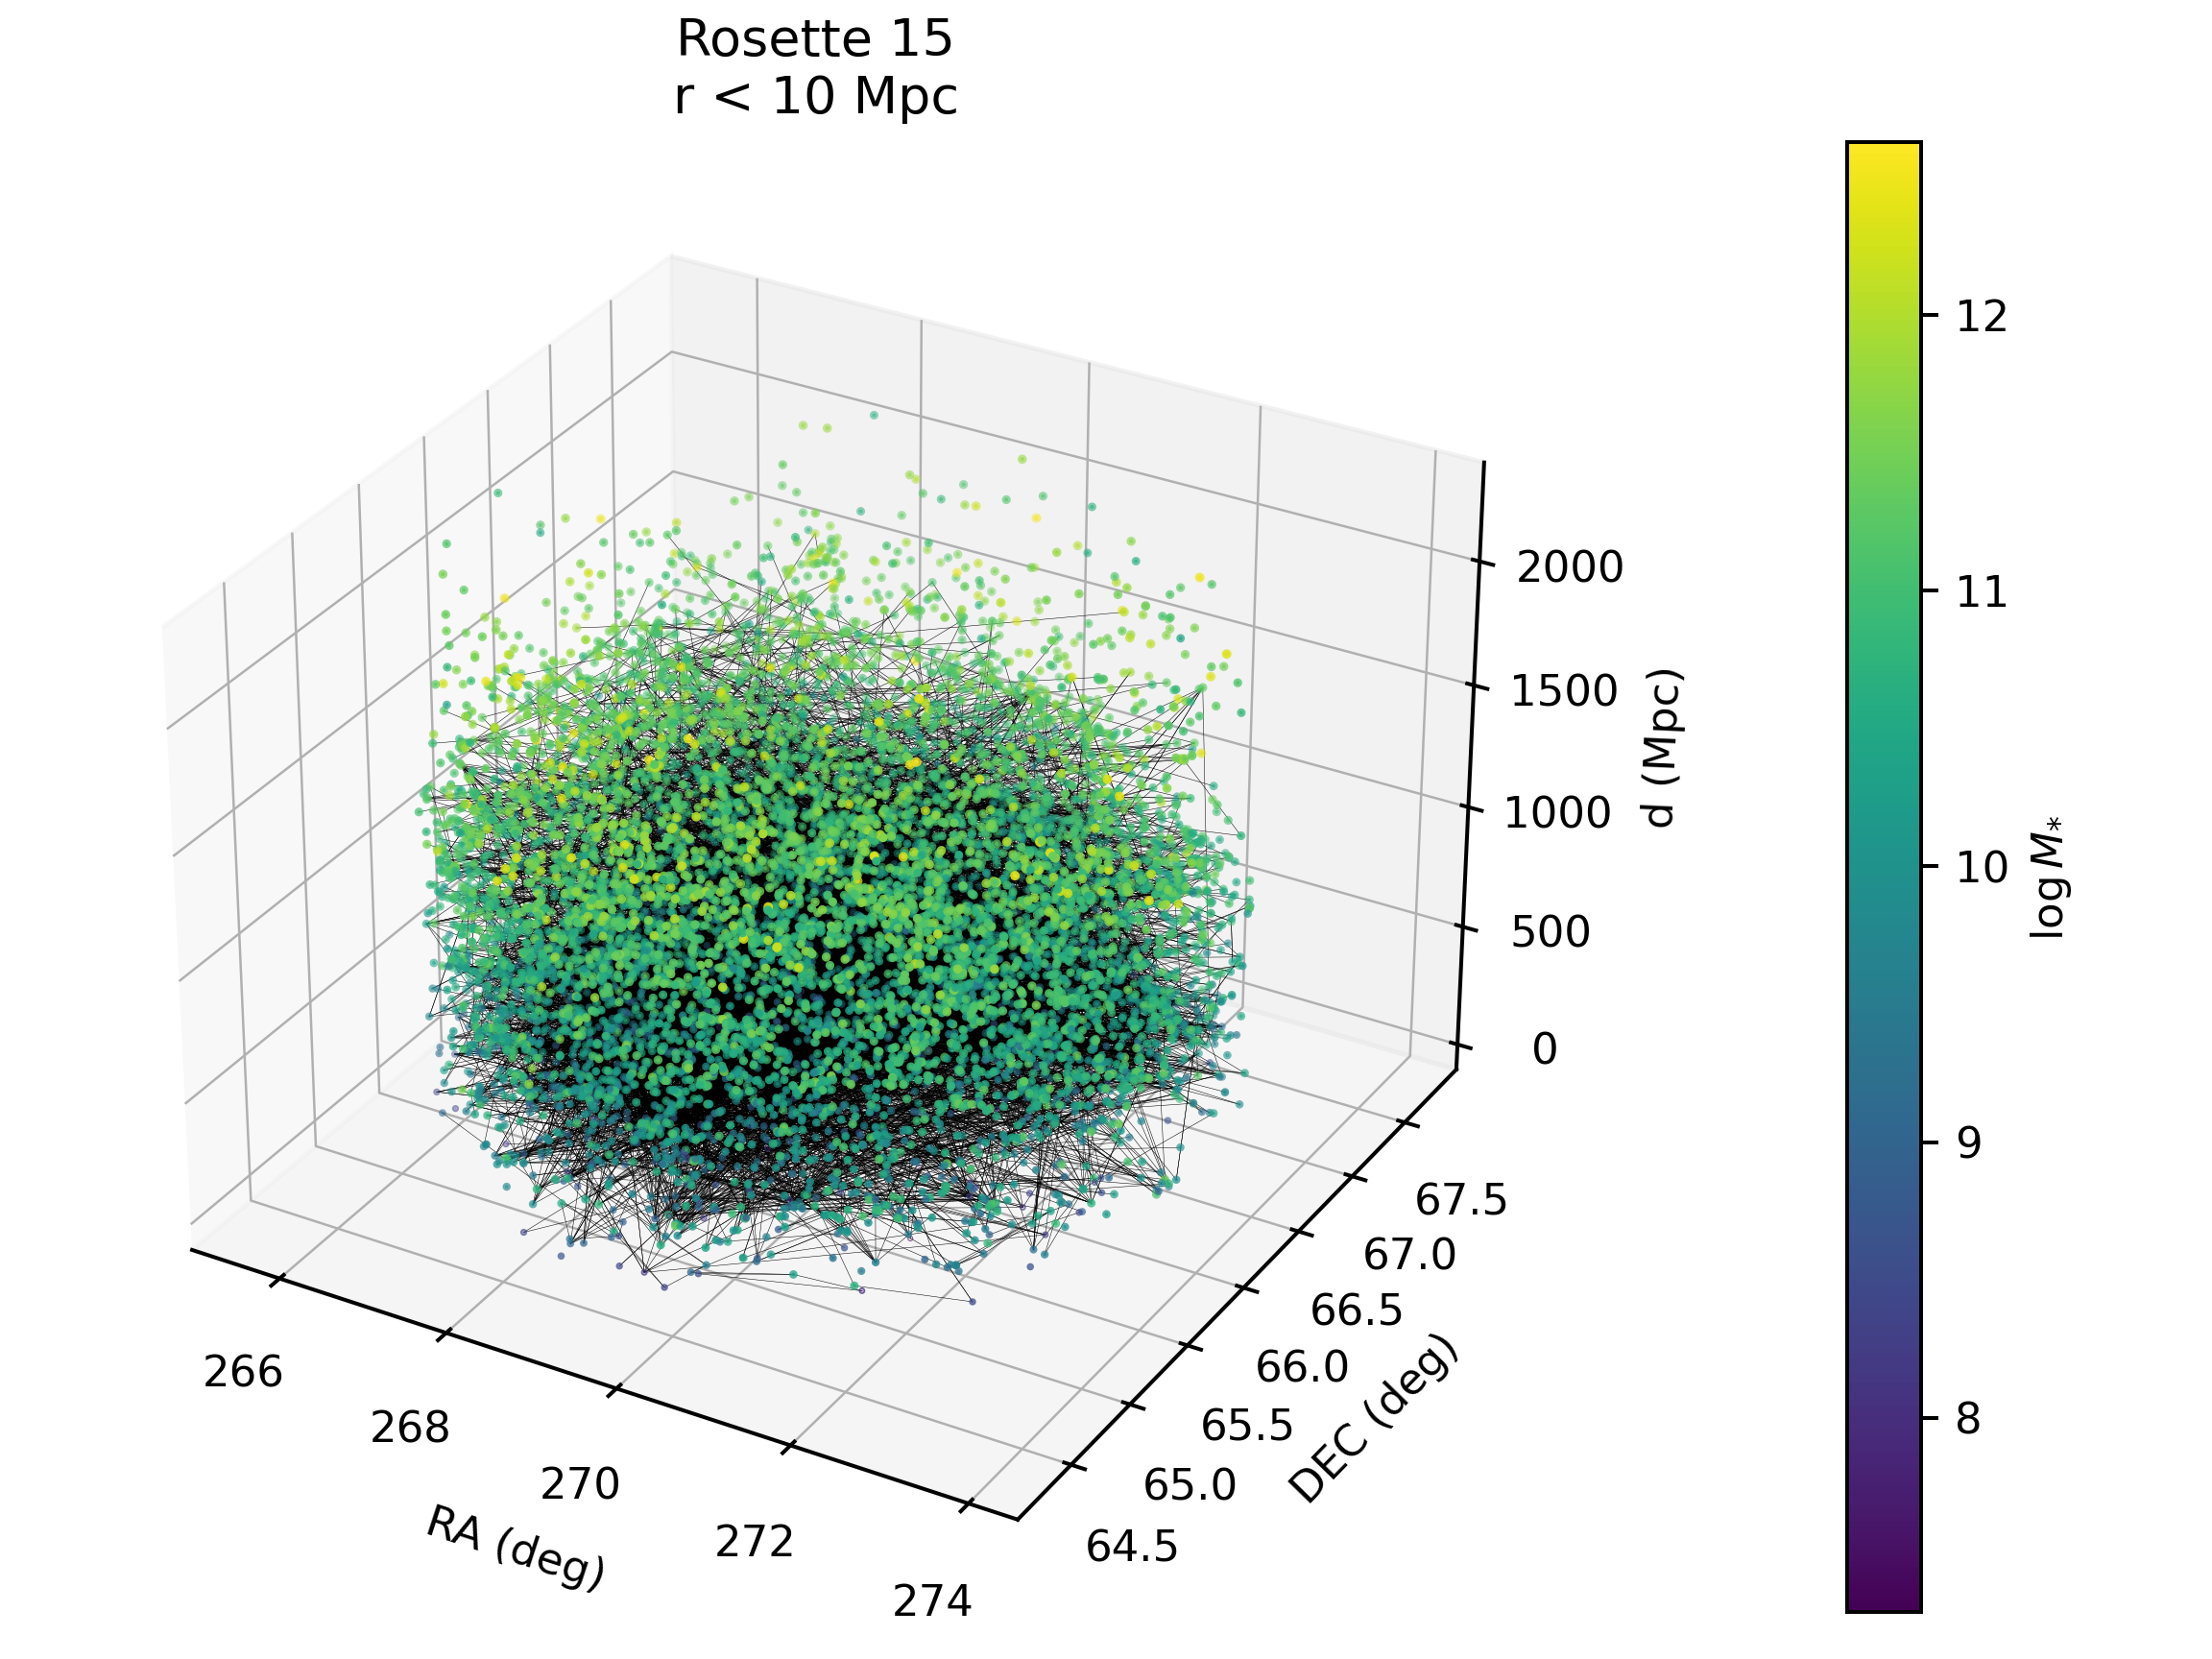
Seminario de astronomía – 27/11/2023
Galaxy stellar mass Estimation with Graph Neural Networks
V. Torres-Gomez
Galaxy stellar mass Estimation with Graph Neural Networks
Slide 1

Slide 2
Seminario de astronomía – 27/11/2023
Graph Neural Network (GNN)
Graph Neural Networks excel in handling irregular and sparse data, making them well-suited for tasks involving the spatial distribution of galaxies ^{[2]}
V. Torres-Gomez
Galaxy stellar mass Estimation with Graph Neural Networks
Slide 2

Slide 3
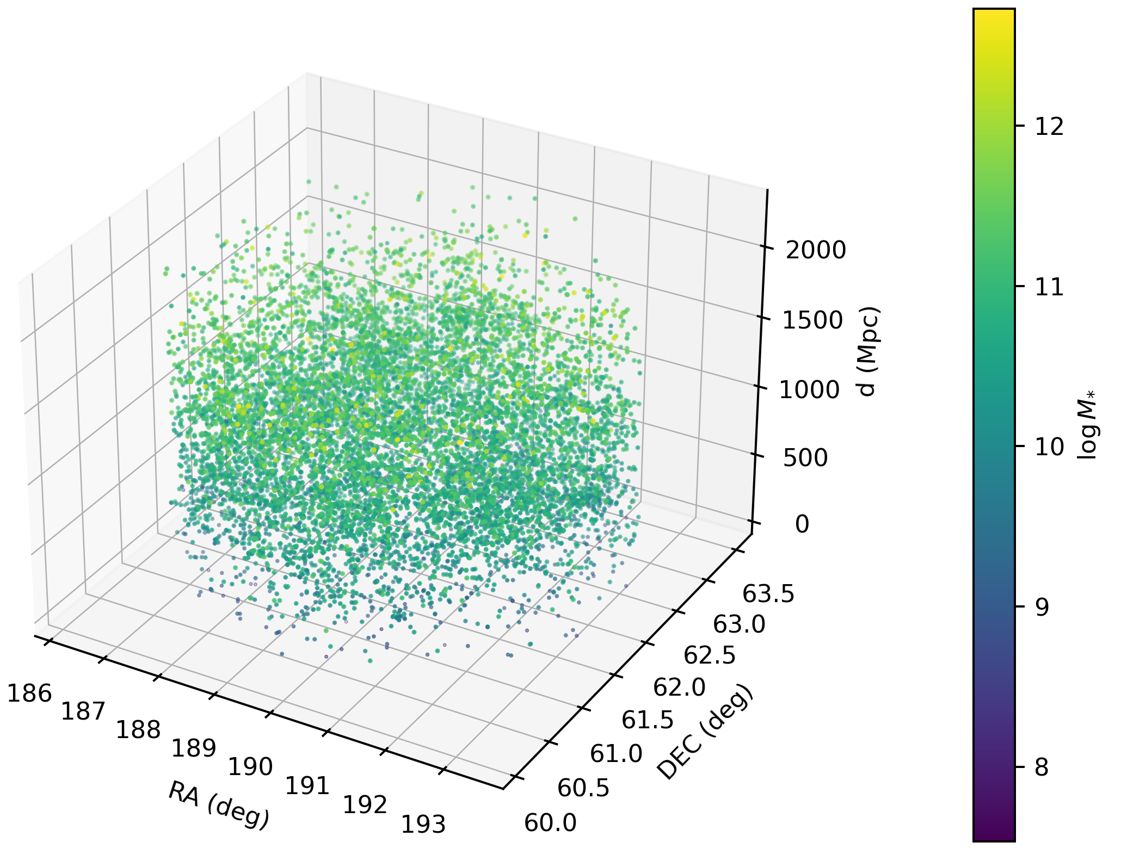
Seminario de astronomía – 27/11/2023
The GNN not only harnesses the intrinsic features of each galaxy, such as fluxes in the R, G, Z, W1, and W2 filters, alongside its redshift Z, but also incorporates the spatial relationship among galaxies through graph construction.
V. Torres-Gomez
Galaxy stellar mass Estimation with Graph Neural Networks
Slide 3

Slide 4
Seminario de astronomía – 27/11/2023
DESI (Dark Energy Spectroscopic Instrument)
DESI will measure the effect of dark energy on the expansion of the universe, constructing a 3D map spanning the nearby universe to 11 billion light years.
Spectra of stellar and extragalactic targets from Survey Validation constitute the first major data sample from the DESI survey ^{[1]}. The public release includes objects targeted as part of good-quality spectral information from objects targeted as part of the Bright Galaxy Survey.
V. Torres-Gomez
Galaxy stellar mass Estimation with Graph Neural Networks
Slide 4

Slide 5
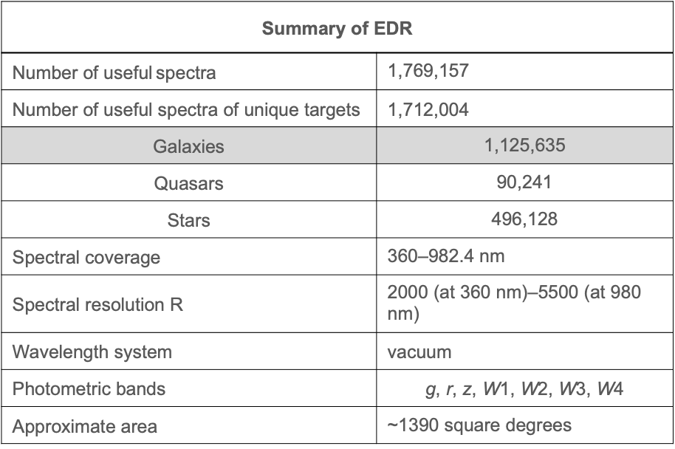
Seminario de astronomía – 27/11/2023
DESI EDR (Early Data Release)
Summary of EDR | $$Edgdes$$
Number of useful spectra | 1,769,157
Number of useful spectra of unique targets | 1,712,004
$$\text{Galaxies}$$ | 1,125,635
$$\text{Quasars}$$ | 90,241
$$\text{Stars}$$ | 496,128
Spectral coverage | 360–982.4 nm
Spectral resolution R | 2000 (at 360 nm)–5500 (at 980 nm)
Wavelength system | vacuum
Photometric bands | $$\text{g}\text{, }\text{r}\text{, }\text{z}\text{, }\text{W}\text{1, }\text{W}\text{2, }\text{W}\text{3, }\text{W}\text{4}$$
Approximate area | ~1390 square degrees
It includes spectra from 1.8 million observed targets, taken from December 2020 to June 2021 ^{[1]}
V. Torres-Gomez
Galaxy stellar mass Estimation with Graph Neural Networks
Slide 5

Slide 6
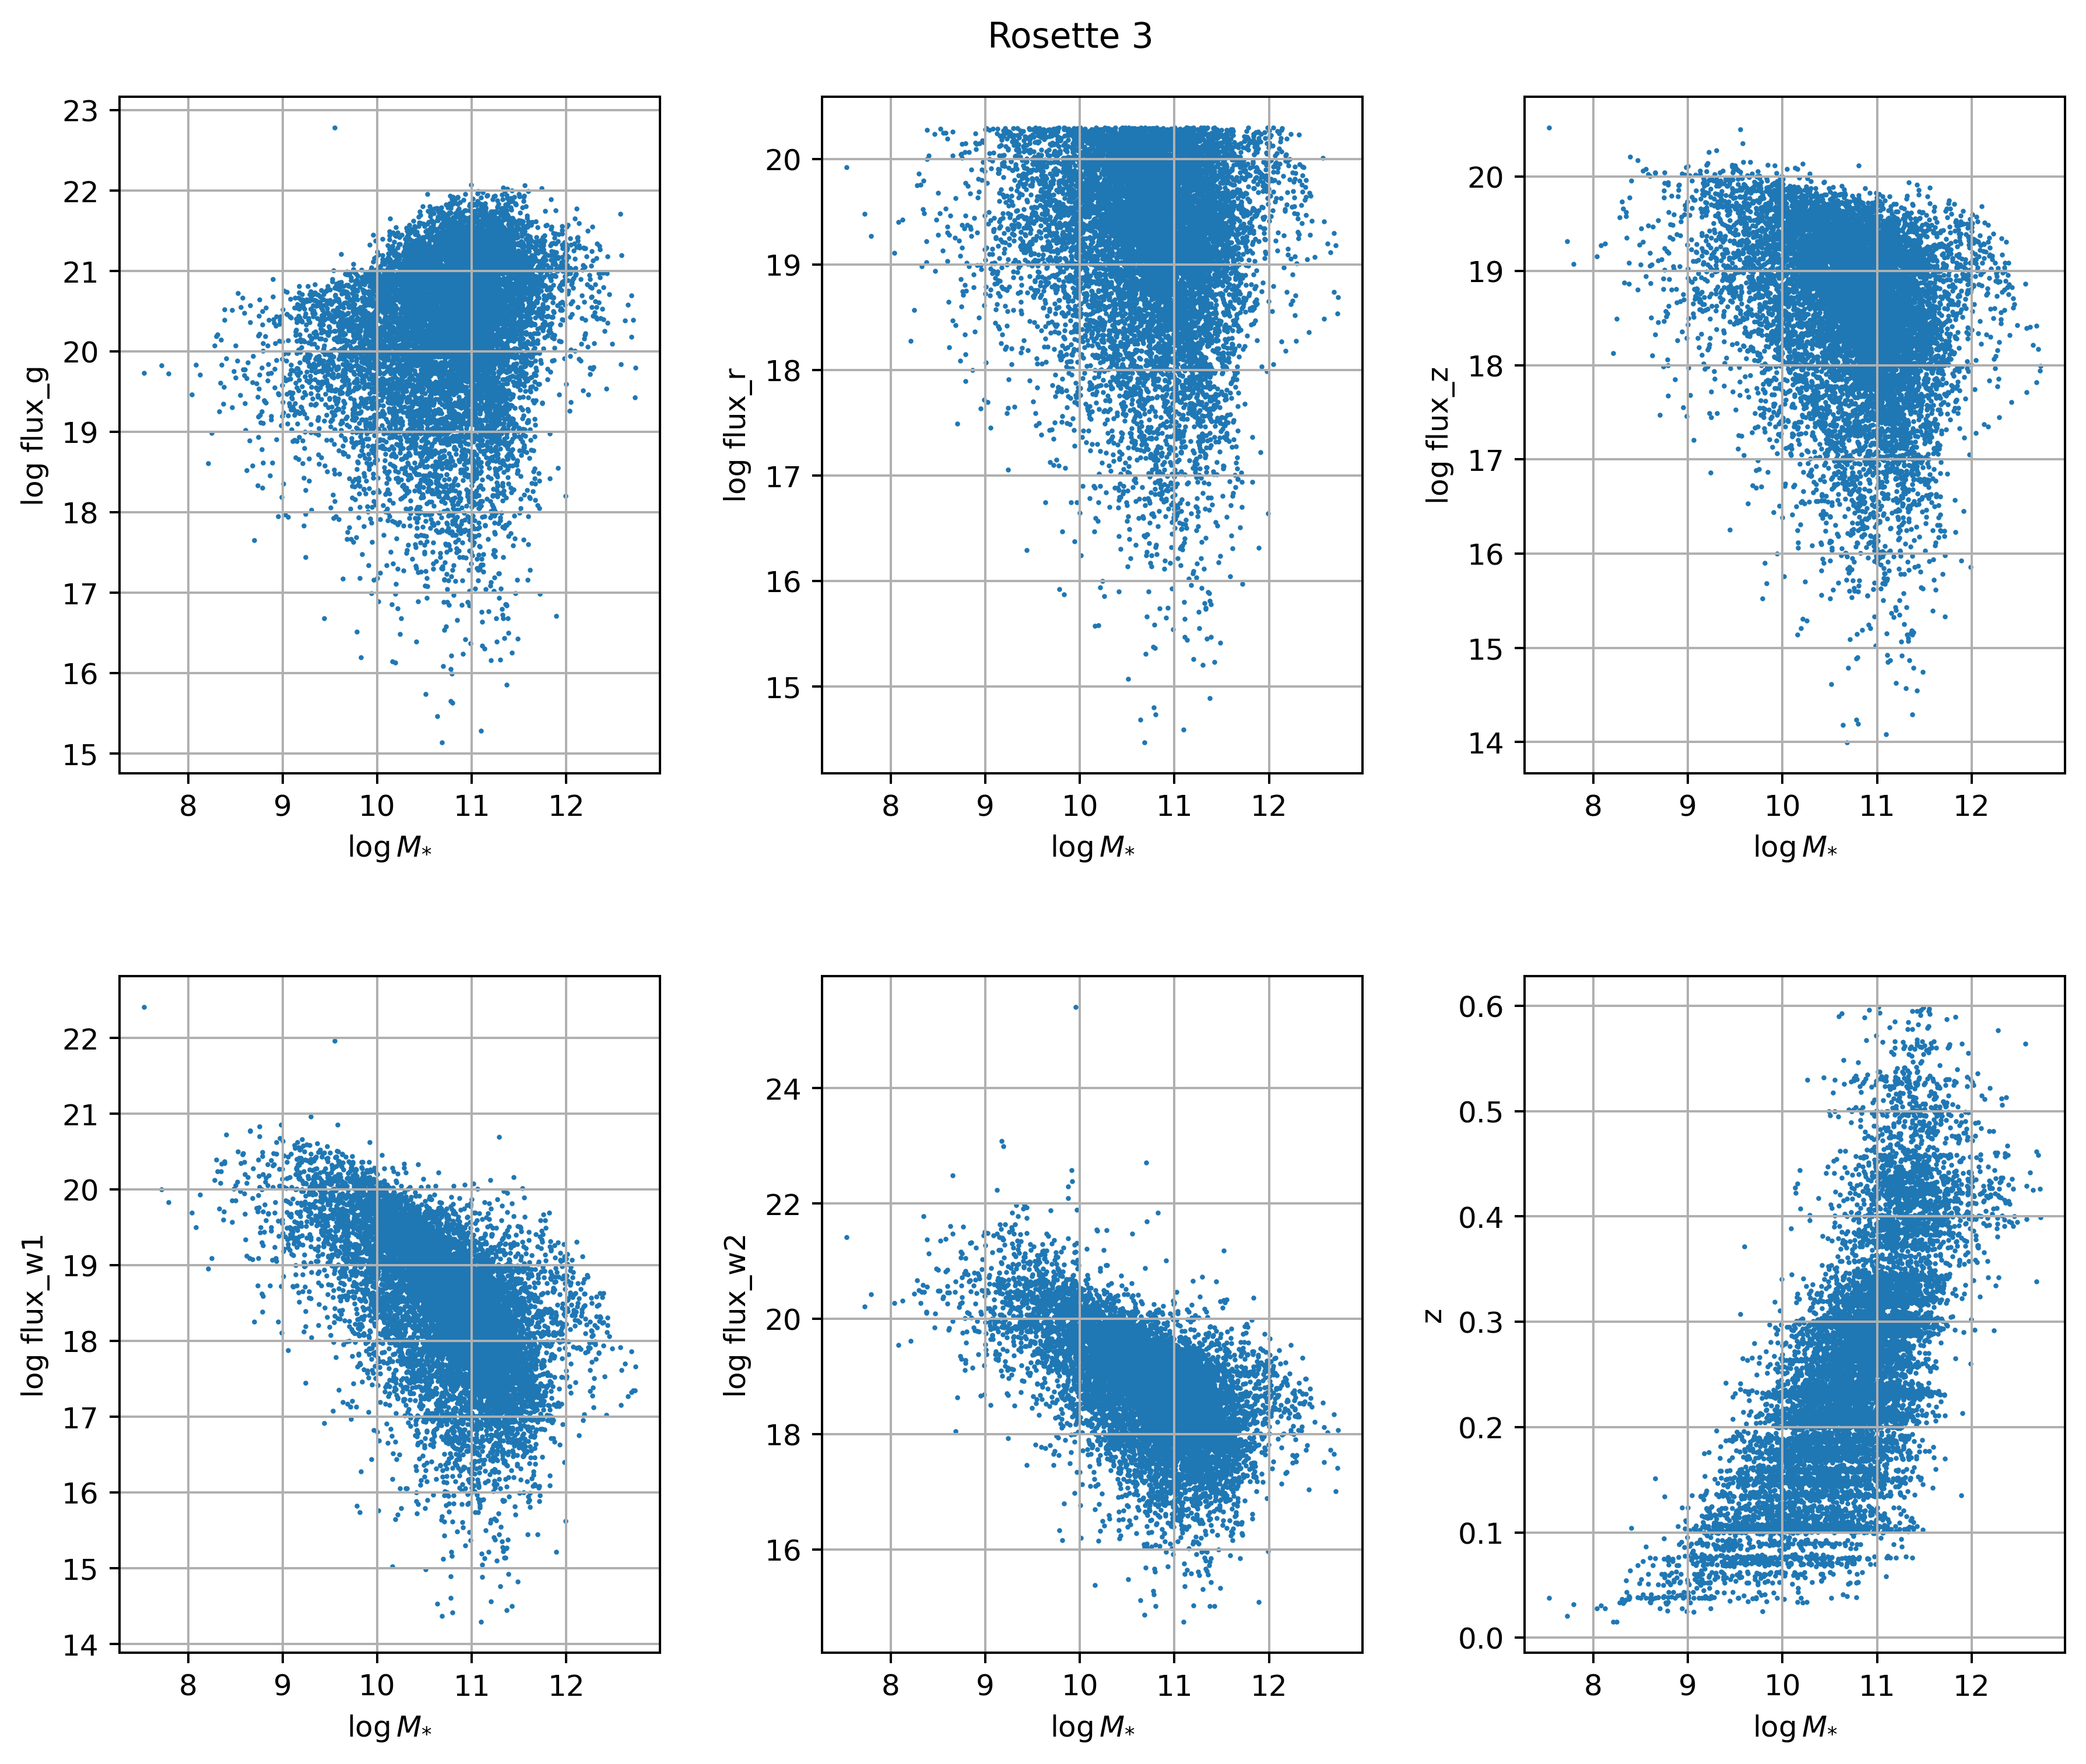
Seminario de astronomía – 27/11/2023
Linear model
Multivariable linear model with fluxes G, R, Z, W1, W2 and redshift Z
V. Torres-Gomez
Galaxy stellar mass Estimation with Graph Neural Networks
Slide 1

Slide 7
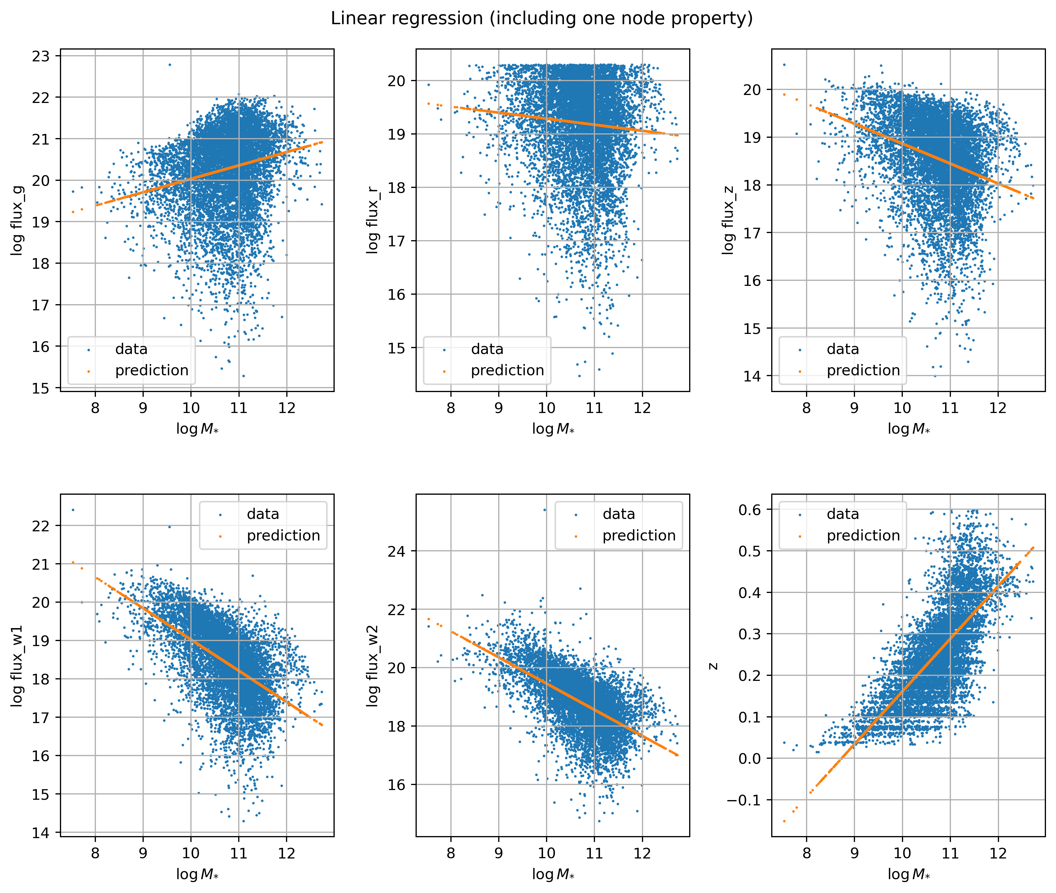
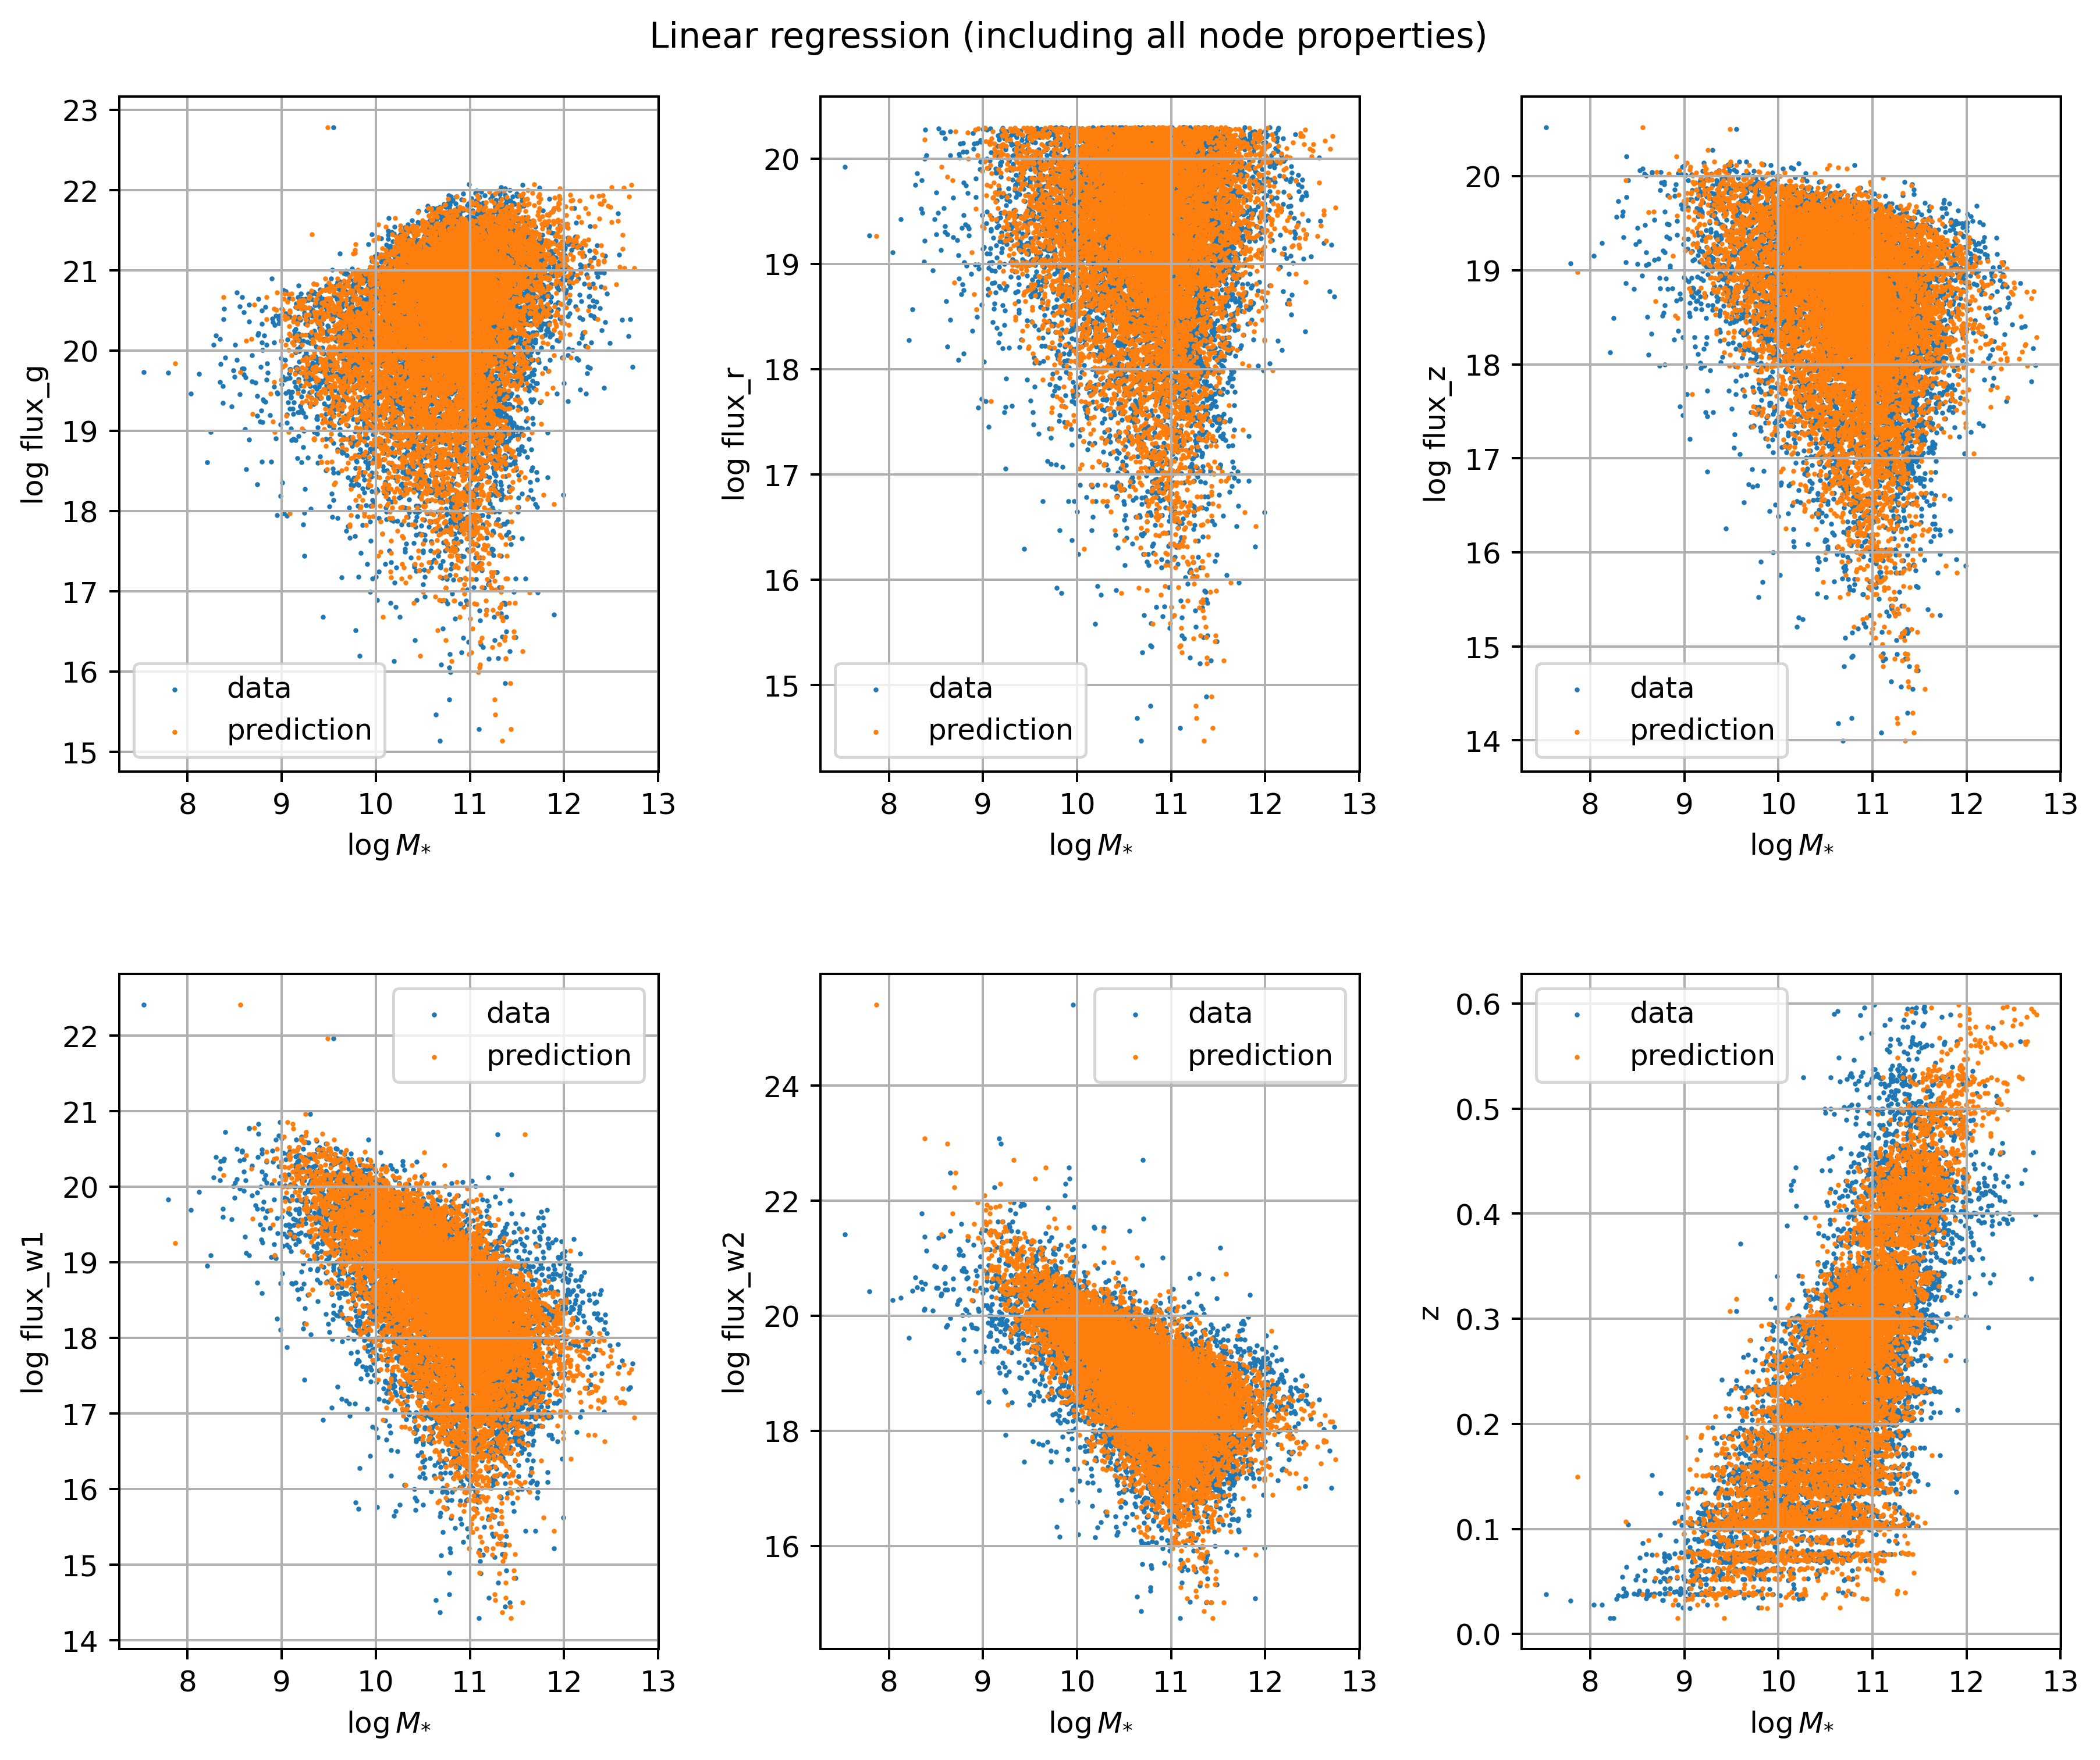

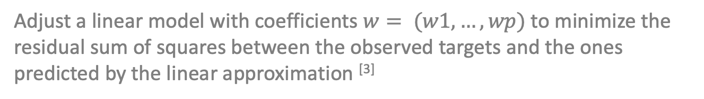
Seminario de astronomía – 27/11/2023
sklearn.linear_model.LinearRegression
Adjust a linear model with coefficients$w= (w1, …, wp)$to minimize the residual sum of squares between the observed targets and the ones predicted by the linear approximation ^{[3]}
V. Torres-Gomez
Galaxy stellar mass Estimation with Graph Neural Networks
Slide 1

Slide 8
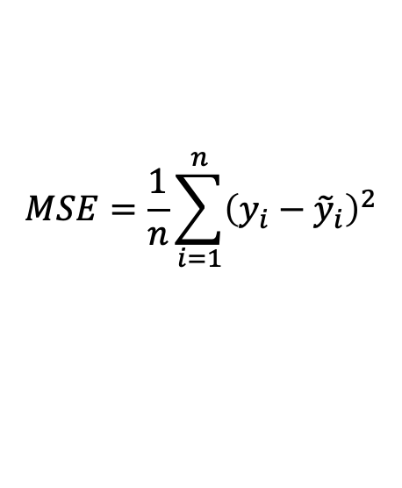
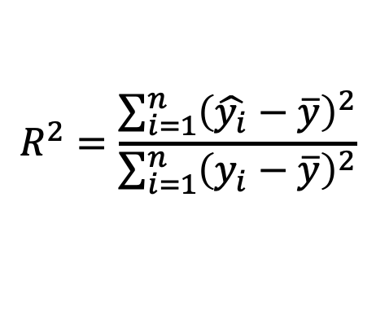
Seminario de astronomía – 27/11/2023
Loss function: Mean Squared Error (MSE)
$$MSE=\frac{1}{n}\sum_{i=1}^{n}{{\left(y_{i}−{\tilde{y}}_{i}\right)}^{2}}$$
Mean squared error between the model predictions and the actual values
Coefficient of determination R²
$$R^{2}=\frac{\sum_{i=1}^{n}{{\left(\hat{y_{i}}−\overline{y}\right)}^{2}}}{\sum_{i=1}^{n}{{\left(y_{i}−\overline{y}\right)}^{2}}}$$
Proportion of variance in the dependent variable that is predictable from the model independent variables
V. Torres-Gomez
Galaxy stellar mass Estimation with Graph Neural Networks
Slide 1

Slide 9
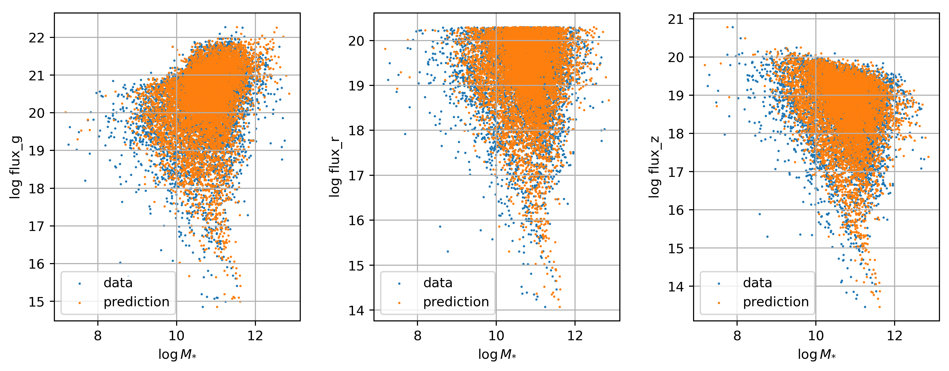
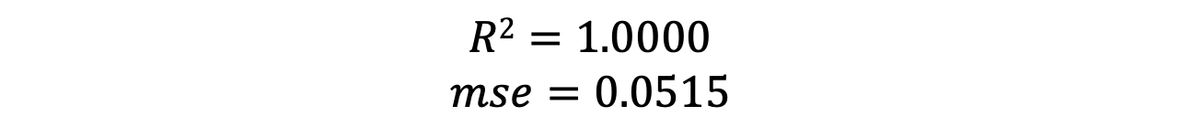
Seminario de astronomía – 27/11/2023
$$R2=1.0000$$
$$mse=0.0515$$
V. Torres-Gomez
Galaxy stellar mass Estimation with Graph Neural Networks
Slide 1

Slide 10
Seminario de astronomía – 27/11/2023
V. Torres-Gomez
Galaxy stellar mass Estimation with Graph Neural Networks
Slide 1

Slide 11
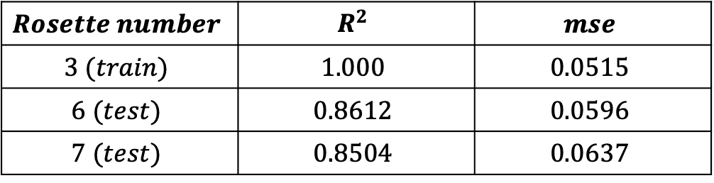
Seminario de astronomía – 27/11/2023
Linear model
Some testing results
$$Rosette number$$ | $$R^{2}$$ | $$mse$$
$$3 (train)$$ | $$1.000$$ | $$0.0515$$
$$6 (test)$$ | $$0.8612$$ | $$0.0596$$
$$7 (test)$$ | $$0.8504$$ | $$0.0637$$
V. Torres-Gomez
Galaxy stellar mass Estimation with Graph Neural Networks
Slide 1

Slide 12
Seminario de astronomía – 27/11/2023
Random Forest
RF model with fluxes G, R, Z, W1, W2 and redshift Z
V. Torres-Gomez
Galaxy stellar mass Estimation with Graph Neural Networks
Slide 1

Slide 13
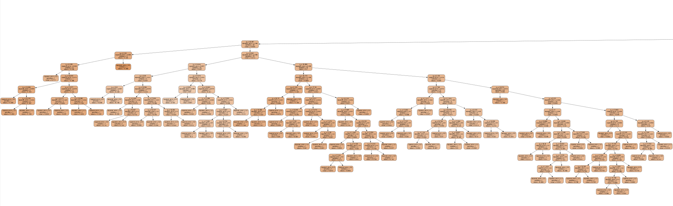
Seminario de astronomía – 27/11/2023
sklearn.ensemble.RandomForestRegressor
Meta-estimator that fits decision trees on different subsets, using averaging to enhance prediction and control overfitting ^{[3]}
V. Torres-Gomez
Galaxy stellar mass Estimation with Graph Neural Networks
Slide 1

Slide 14
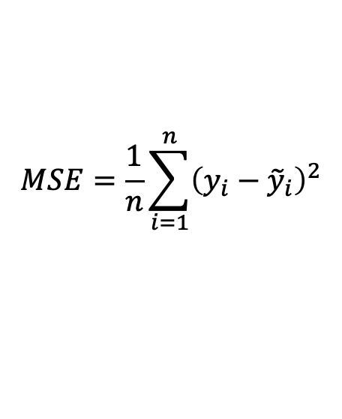
Seminario de astronomía – 27/11/2023
Loss function: Mean Squared Error (MSE)
$$MSE=\frac{1}{n}\sum_{i=1}^{n}{{\left(y_{i}−{\tilde{y}}_{i}\right)}^{2}}$$
Mean squared error between the model predictions and the actual values
V. Torres-Gomez
Galaxy stellar mass Estimation with Graph Neural Networks
Slide 1

Slide 15
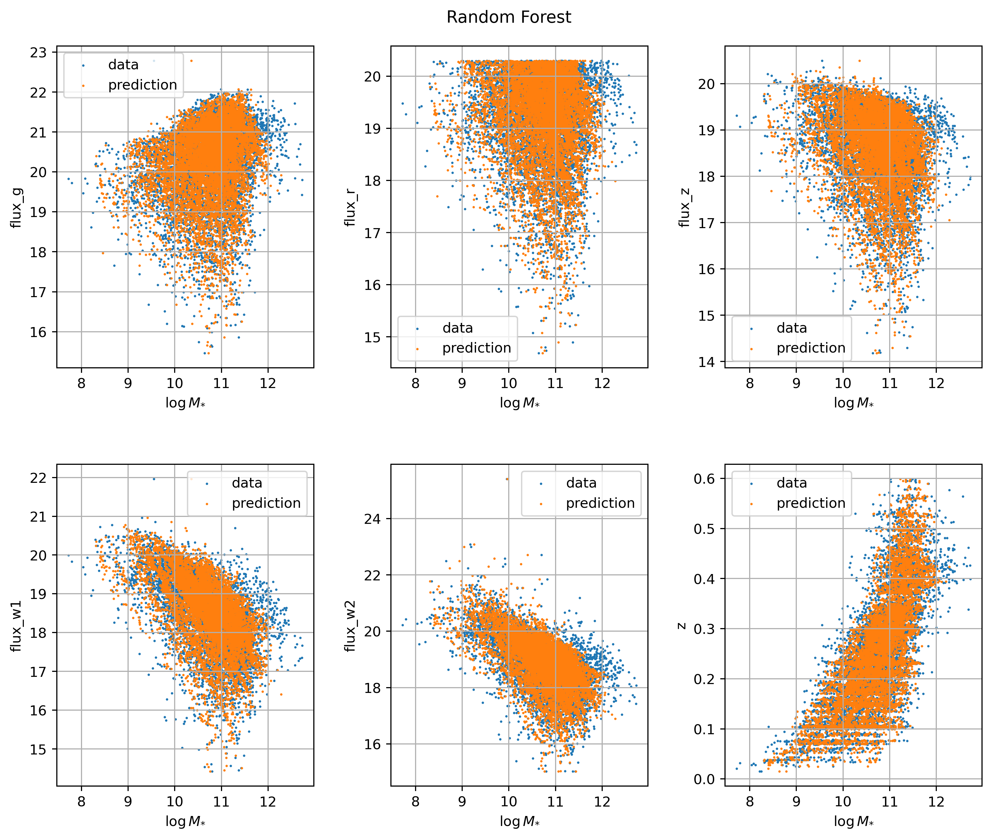
Seminario de astronomía – 27/11/2023
$$mse=0.0357$$
V. Torres-Gomez
Galaxy stellar mass Estimation with Graph Neural Networks
Slide 1

Slide 16
Seminario de astronomía – 27/11/2023
V. Torres-Gomez
Galaxy stellar mass Estimation with Graph Neural Networks
Slide 1

Slide 17
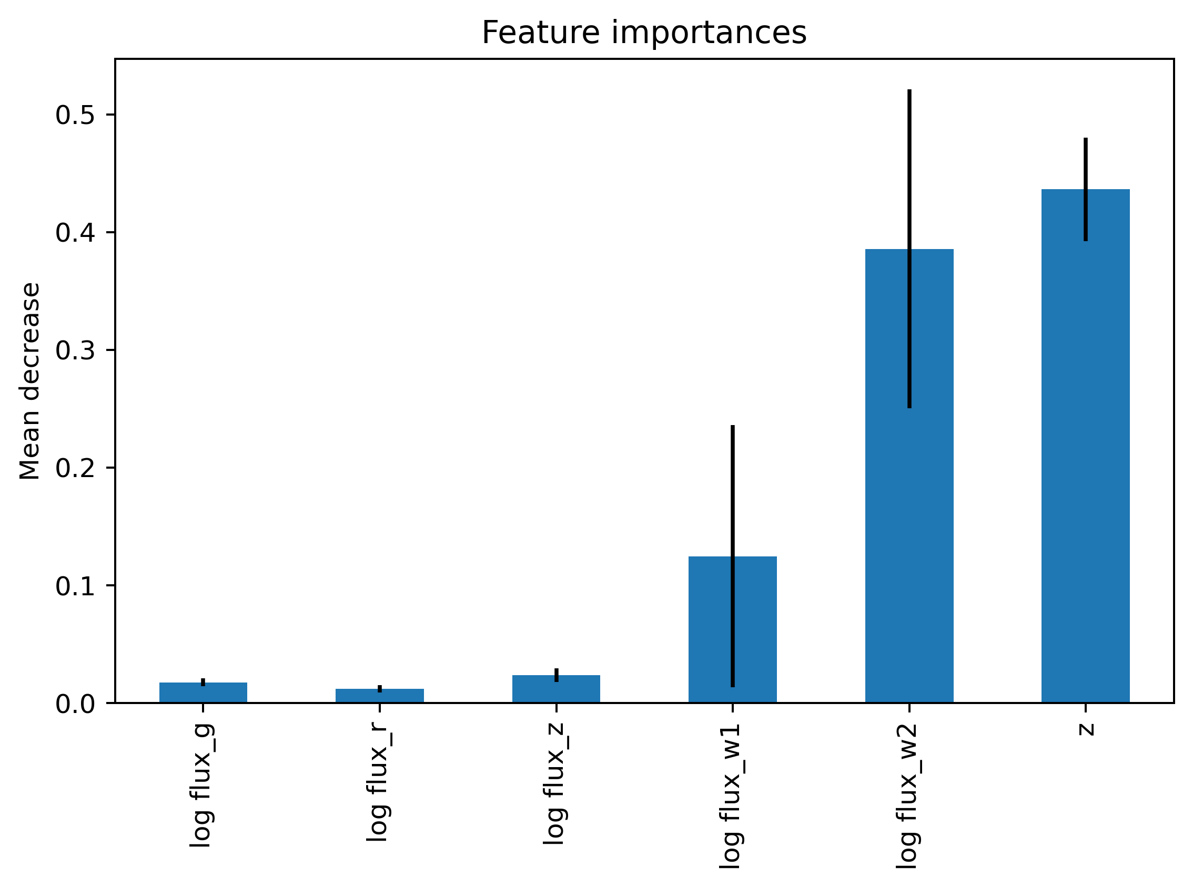
Seminario de astronomía – 27/11/2023
Random Subset Feature Selection
(RSFS)
Introduces additional randomness in the model-building process to enhance generalization and reduce overfitting
V. Torres-Gomez
Galaxy stellar mass Estimation with Graph Neural Networks
Slide 1

Slide 18
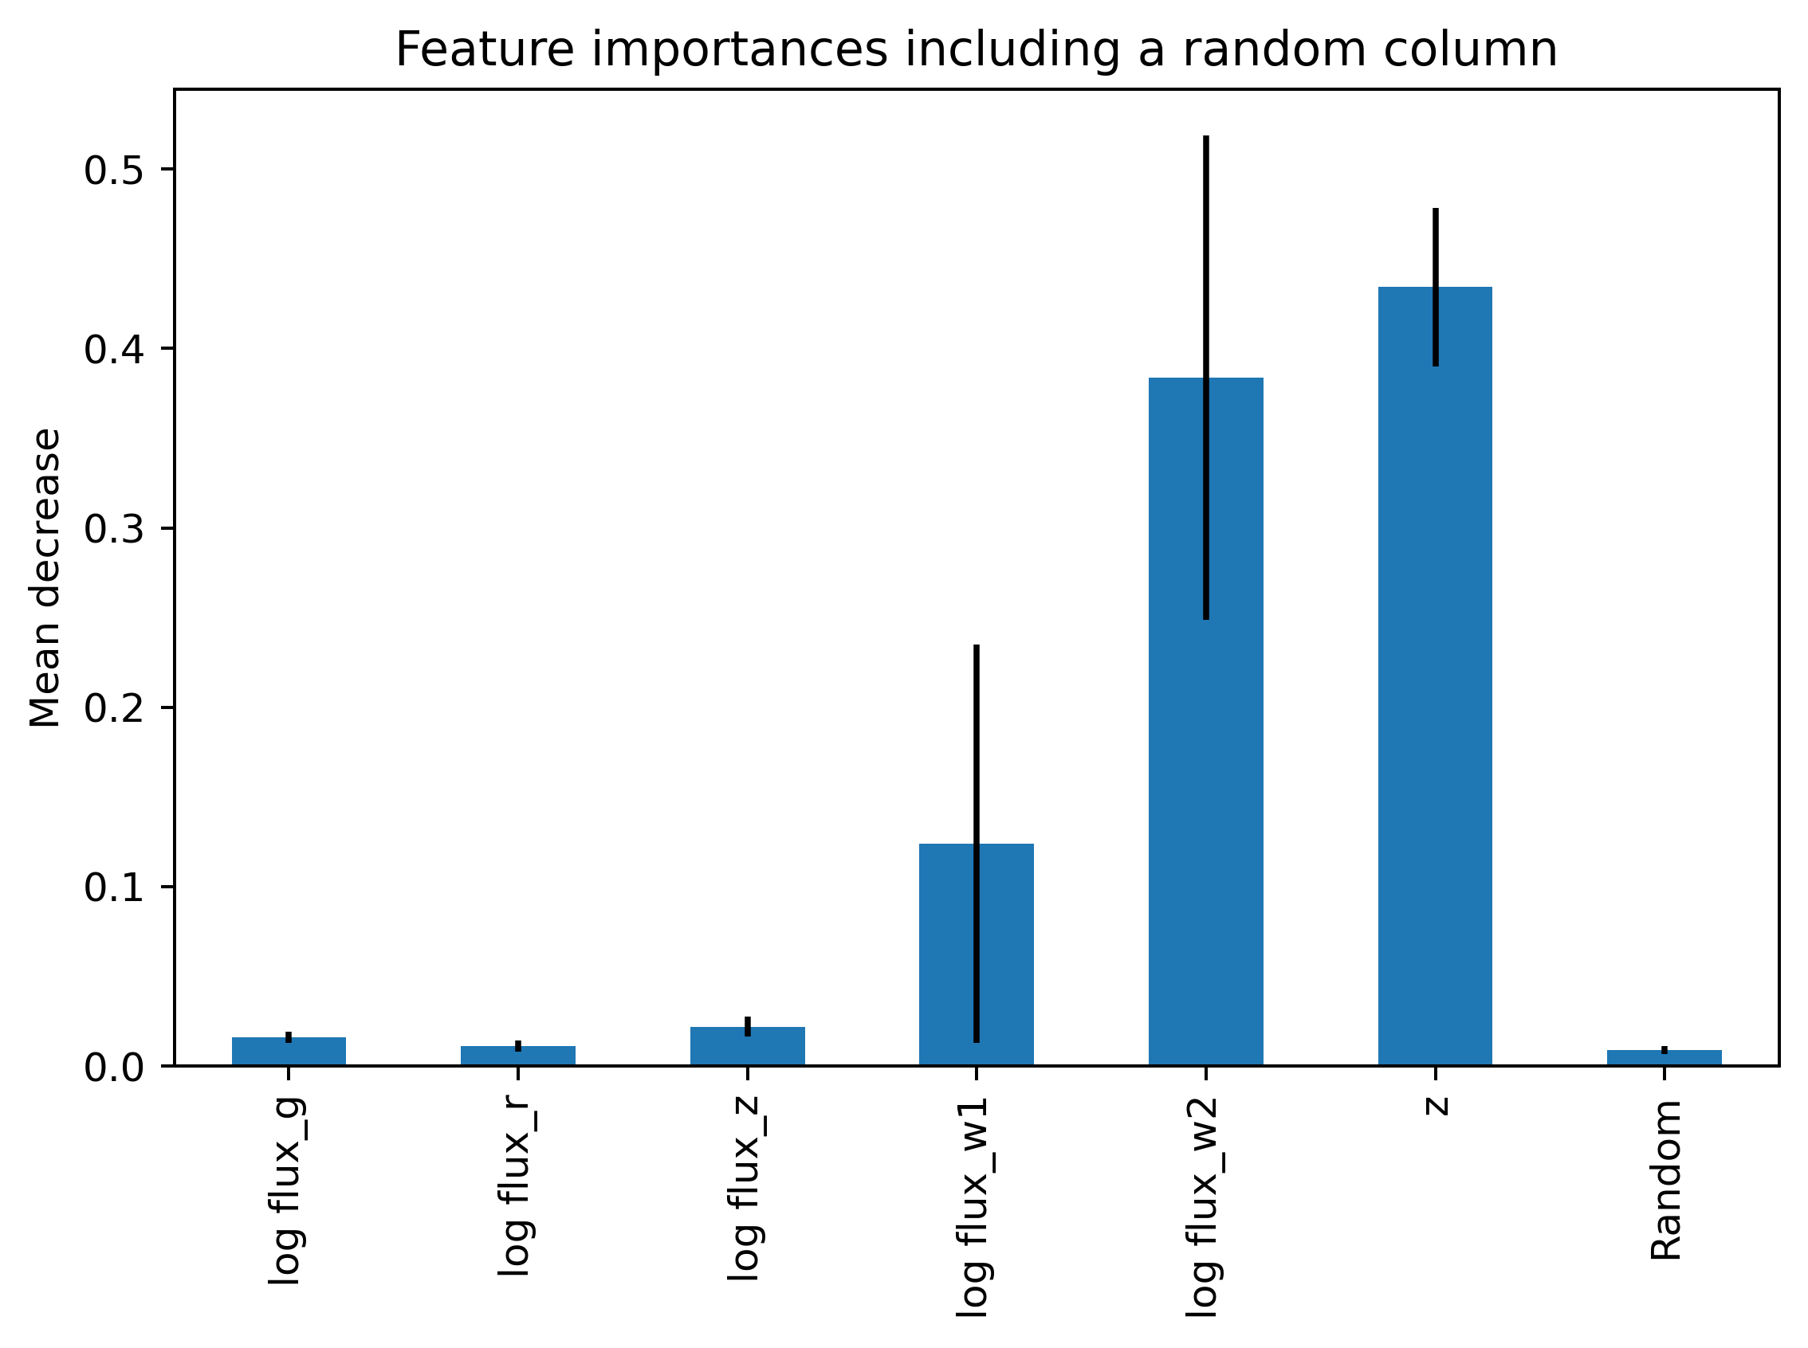
Seminario de astronomía – 27/11/2023
Reduction of correlation between trees
Overfitting prevention
Increased robustness
V. Torres-Gomez
Galaxy stellar mass Estimation with Graph Neural Networks
Slide 1

Slide 19
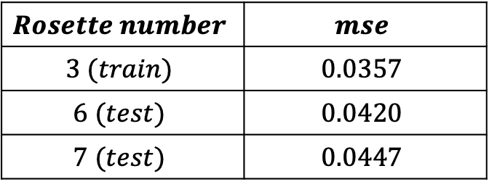
Seminario de astronomía – 27/11/2023
Random Forest model
Some testing results
$$Rosette number$$ | $$mse$$
$$3 (train)$$ | $$0.0357$$
$$6 (test)$$ | $$0.0420$$
$$7 (test)$$ | $$0.0447$$
V. Torres-Gomez
Galaxy stellar mass Estimation with Graph Neural Networks
Slide 1

Slide 20
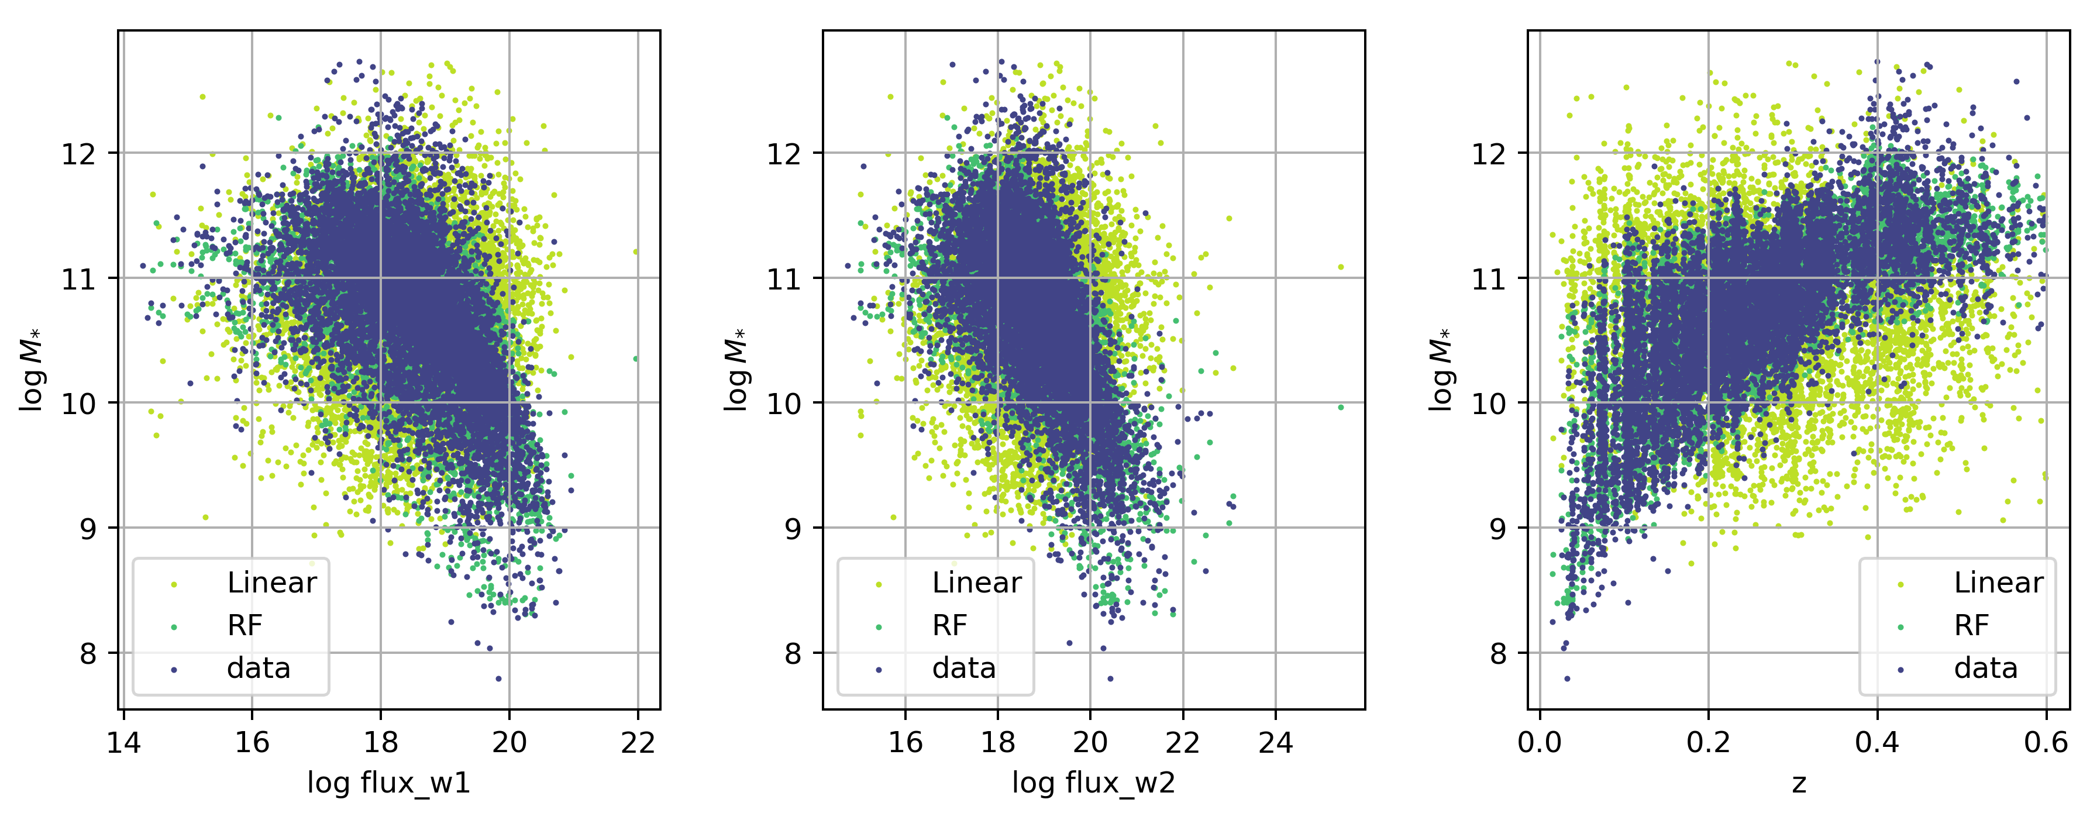
Seminario de astronomía – 27/11/2023
RF and Linear
V. Torres-Gomez
Galaxy stellar mass Estimation with Graph Neural Networks
Slide 1

Slide 21
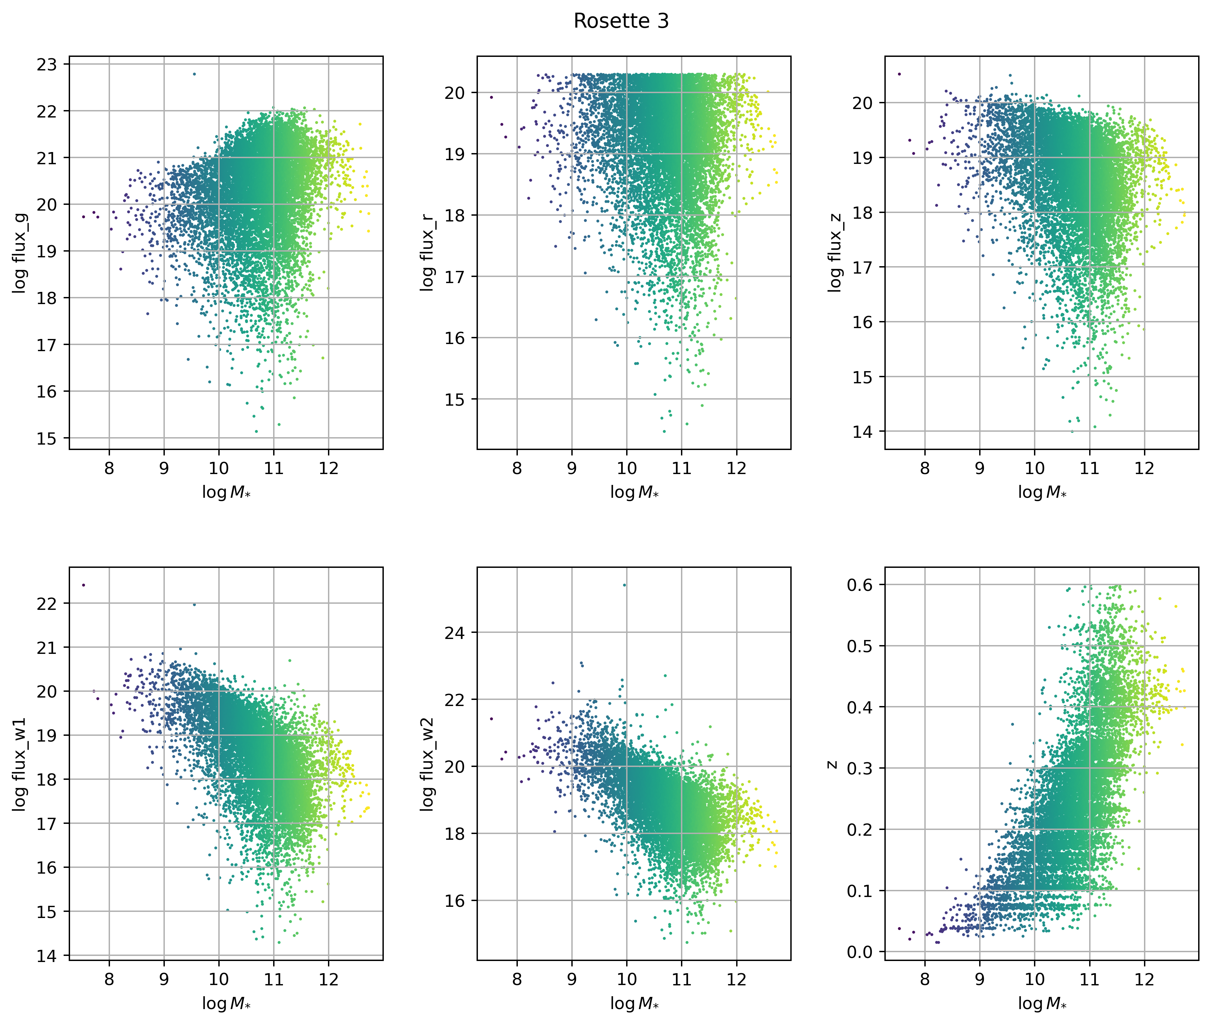
Seminario de astronomía – 27/11/2023
Graph Neural Network
V. Torres-Gomez
Galaxy stellar mass Estimation with Graph Neural Networks
Slide 1

Slide 22
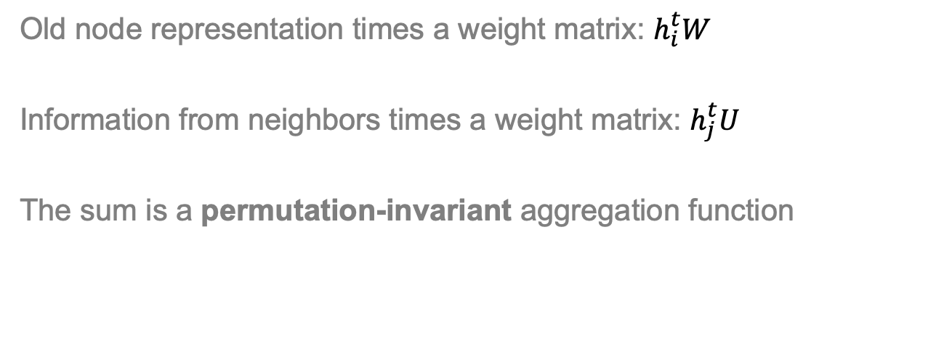
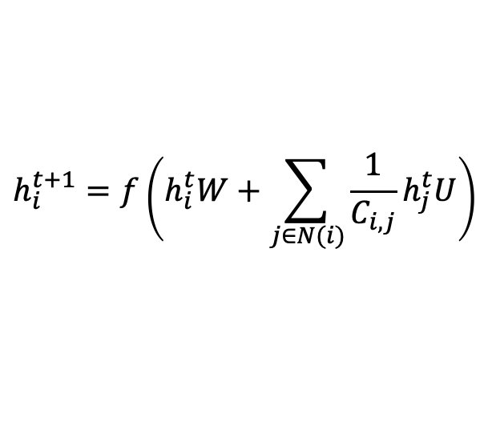
Seminario de astronomía – 27/11/2023
About GNNs
$$h_{i}^{t+1}=f\left(h_{i}^{t}W+\sum_{j∈N(i)}{\frac{1}{C_{i,j}}h_{j}^{t}U}\right)$$
Old node representation times a weight matrix: $h_{i}^{t}W$
Information from neighbors times a weight matrix: $h_{j}^{t}U$
The sum is a permutation-invariant aggregation function
V. Torres-Gomez
Galaxy stellar mass Estimation with Graph Neural Networks
Slide 1

Slide 23
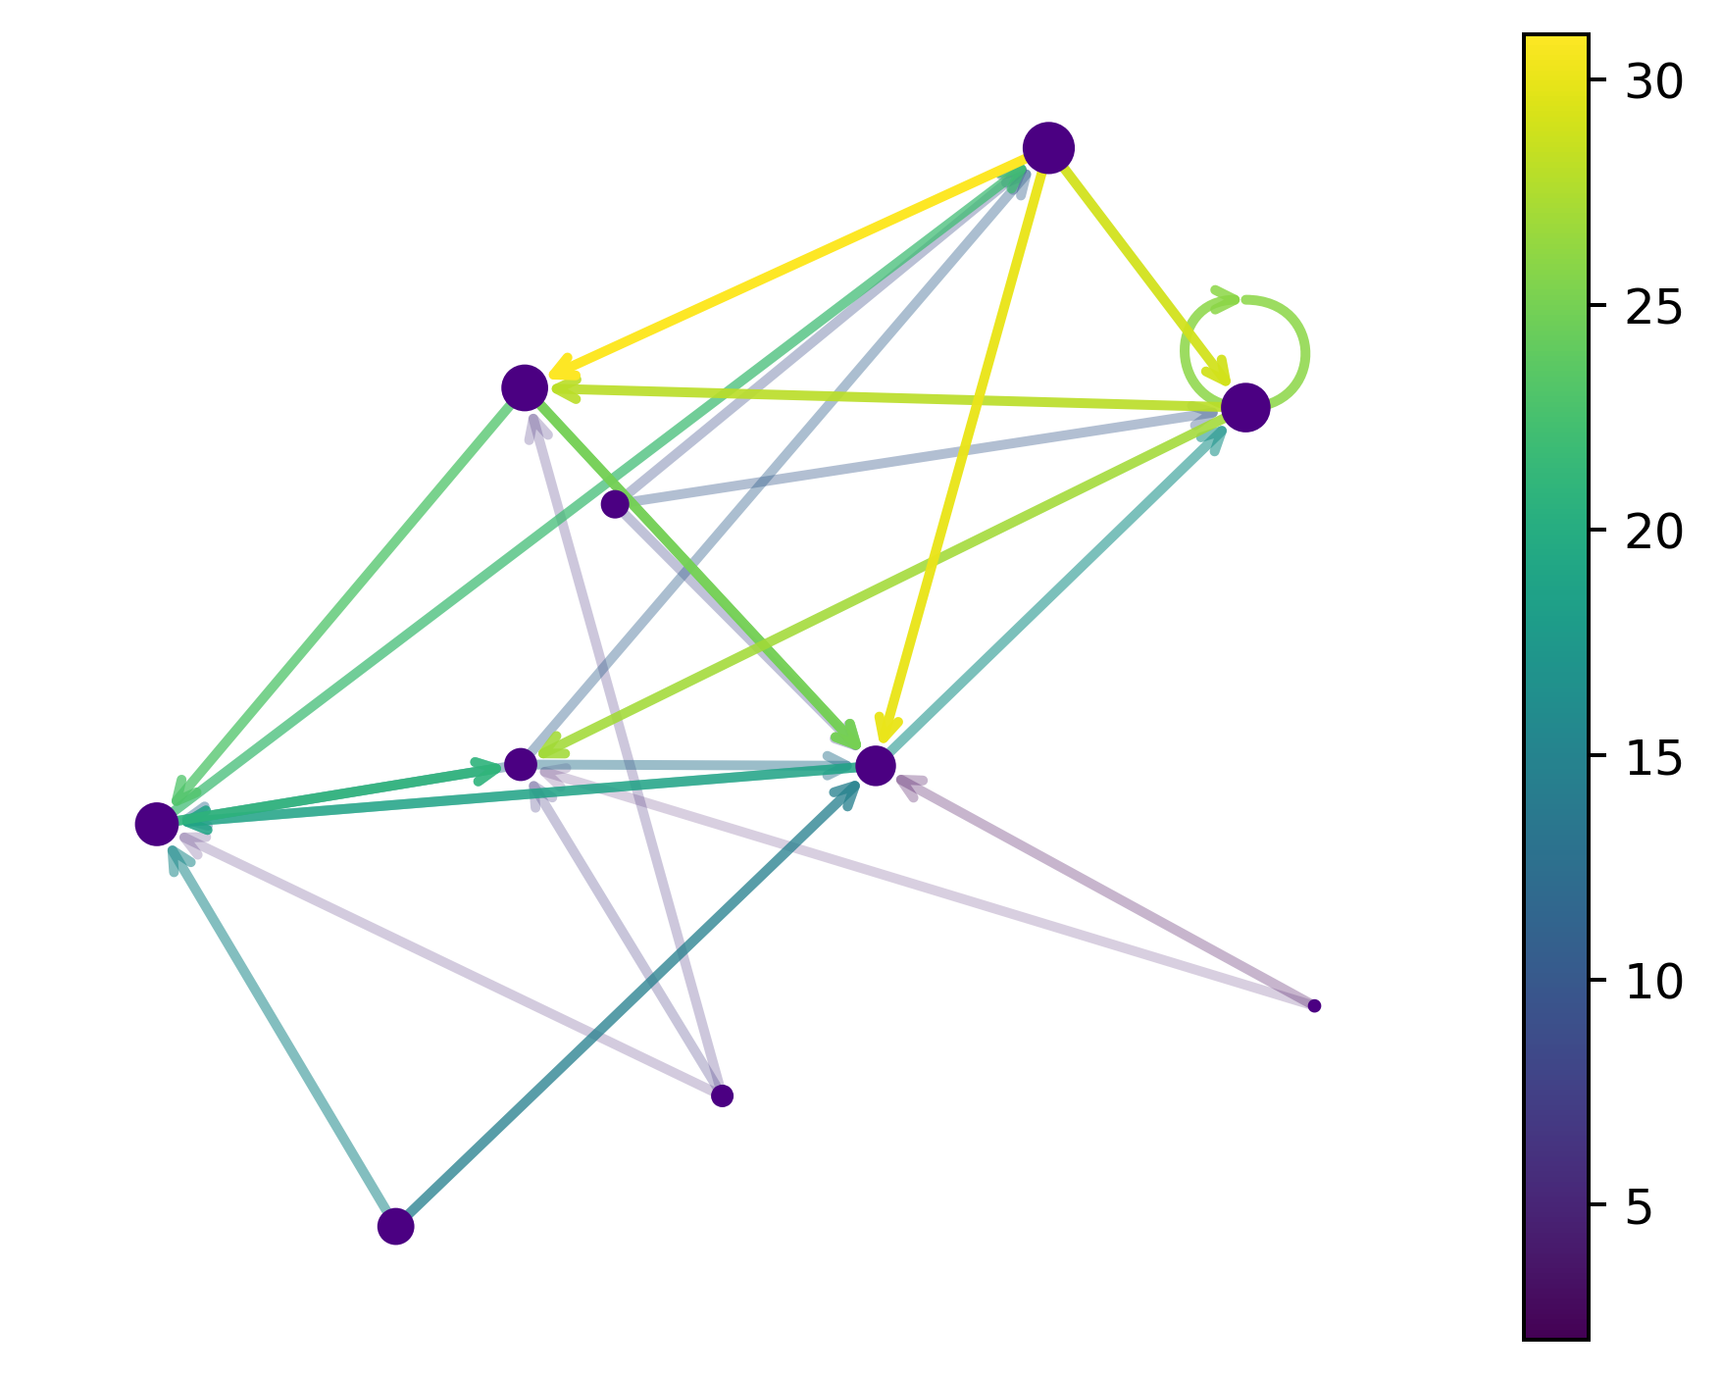
Seminario de astronomía – 27/11/2023
Graphs
A simple graph G consists of a non-empty finite set V(G) of elements called vertices (or nodes), and a finite set E(G) of distinct unordered pairs of distinct elements from V(G) called edges (or arcs) ^{[4]}
V. Torres-Gomez
Galaxy stellar mass Estimation with Graph Neural Networks
Slide 1

Slide 24
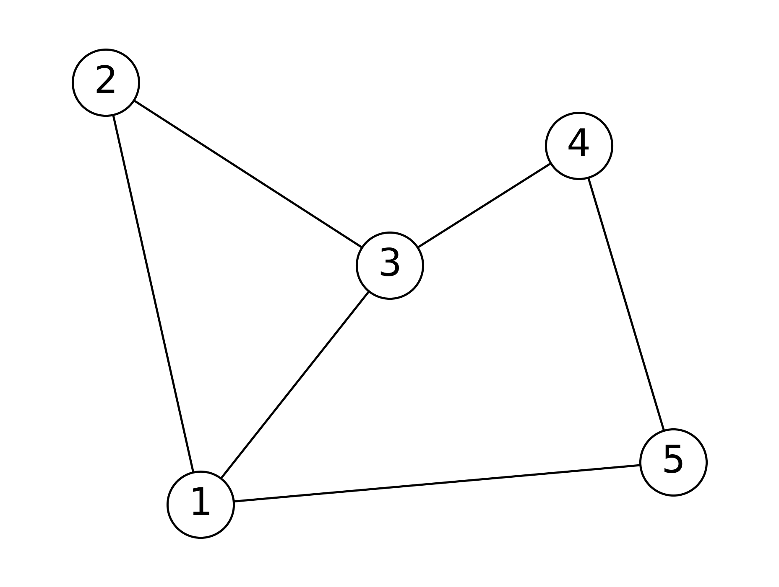
Seminario de astronomía – 27/11/2023
Some definitions
Adjacency: two vertices v and w of a graph G are adjacent if there is an edge vw joining-them ^{[4]}
Degree: the degree of a vertex v of G is the number of edges incident with v ^{[4]}
V. Torres-Gomez
Galaxy stellar mass Estimation with Graph Neural Networks
Slide 1

Slide 25
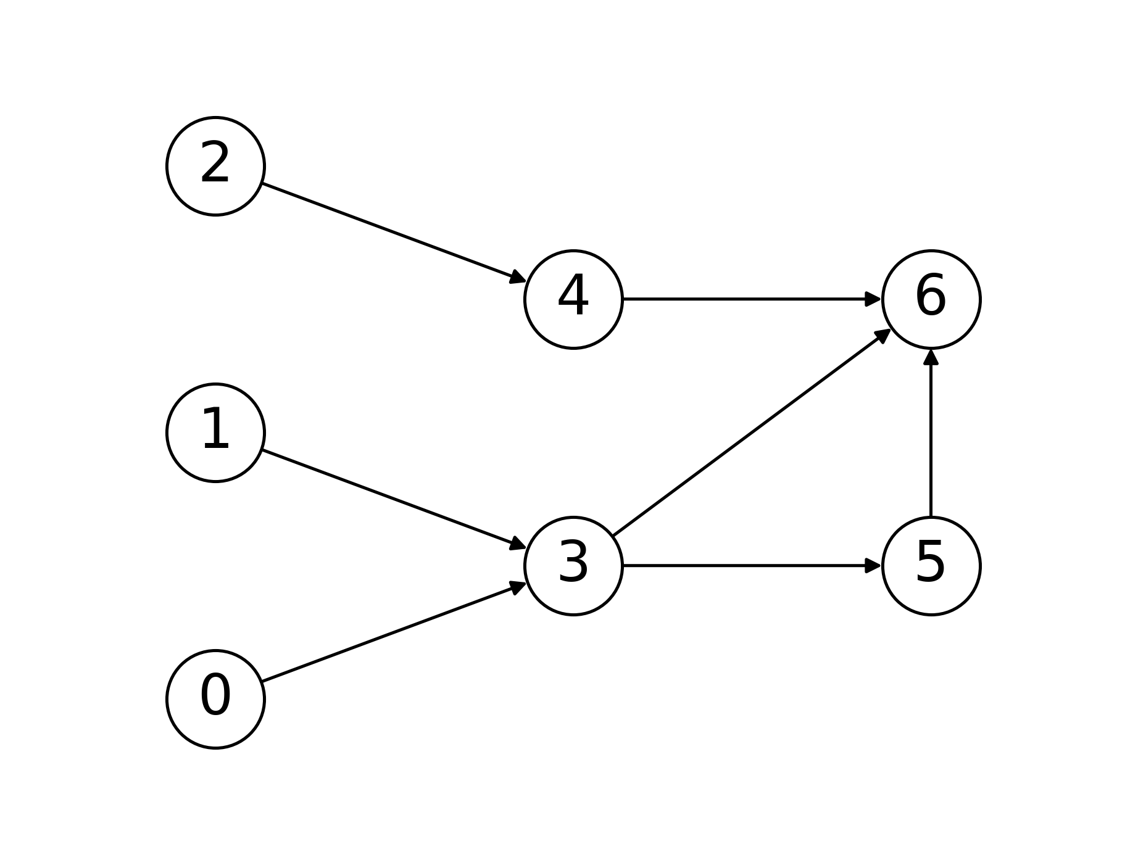
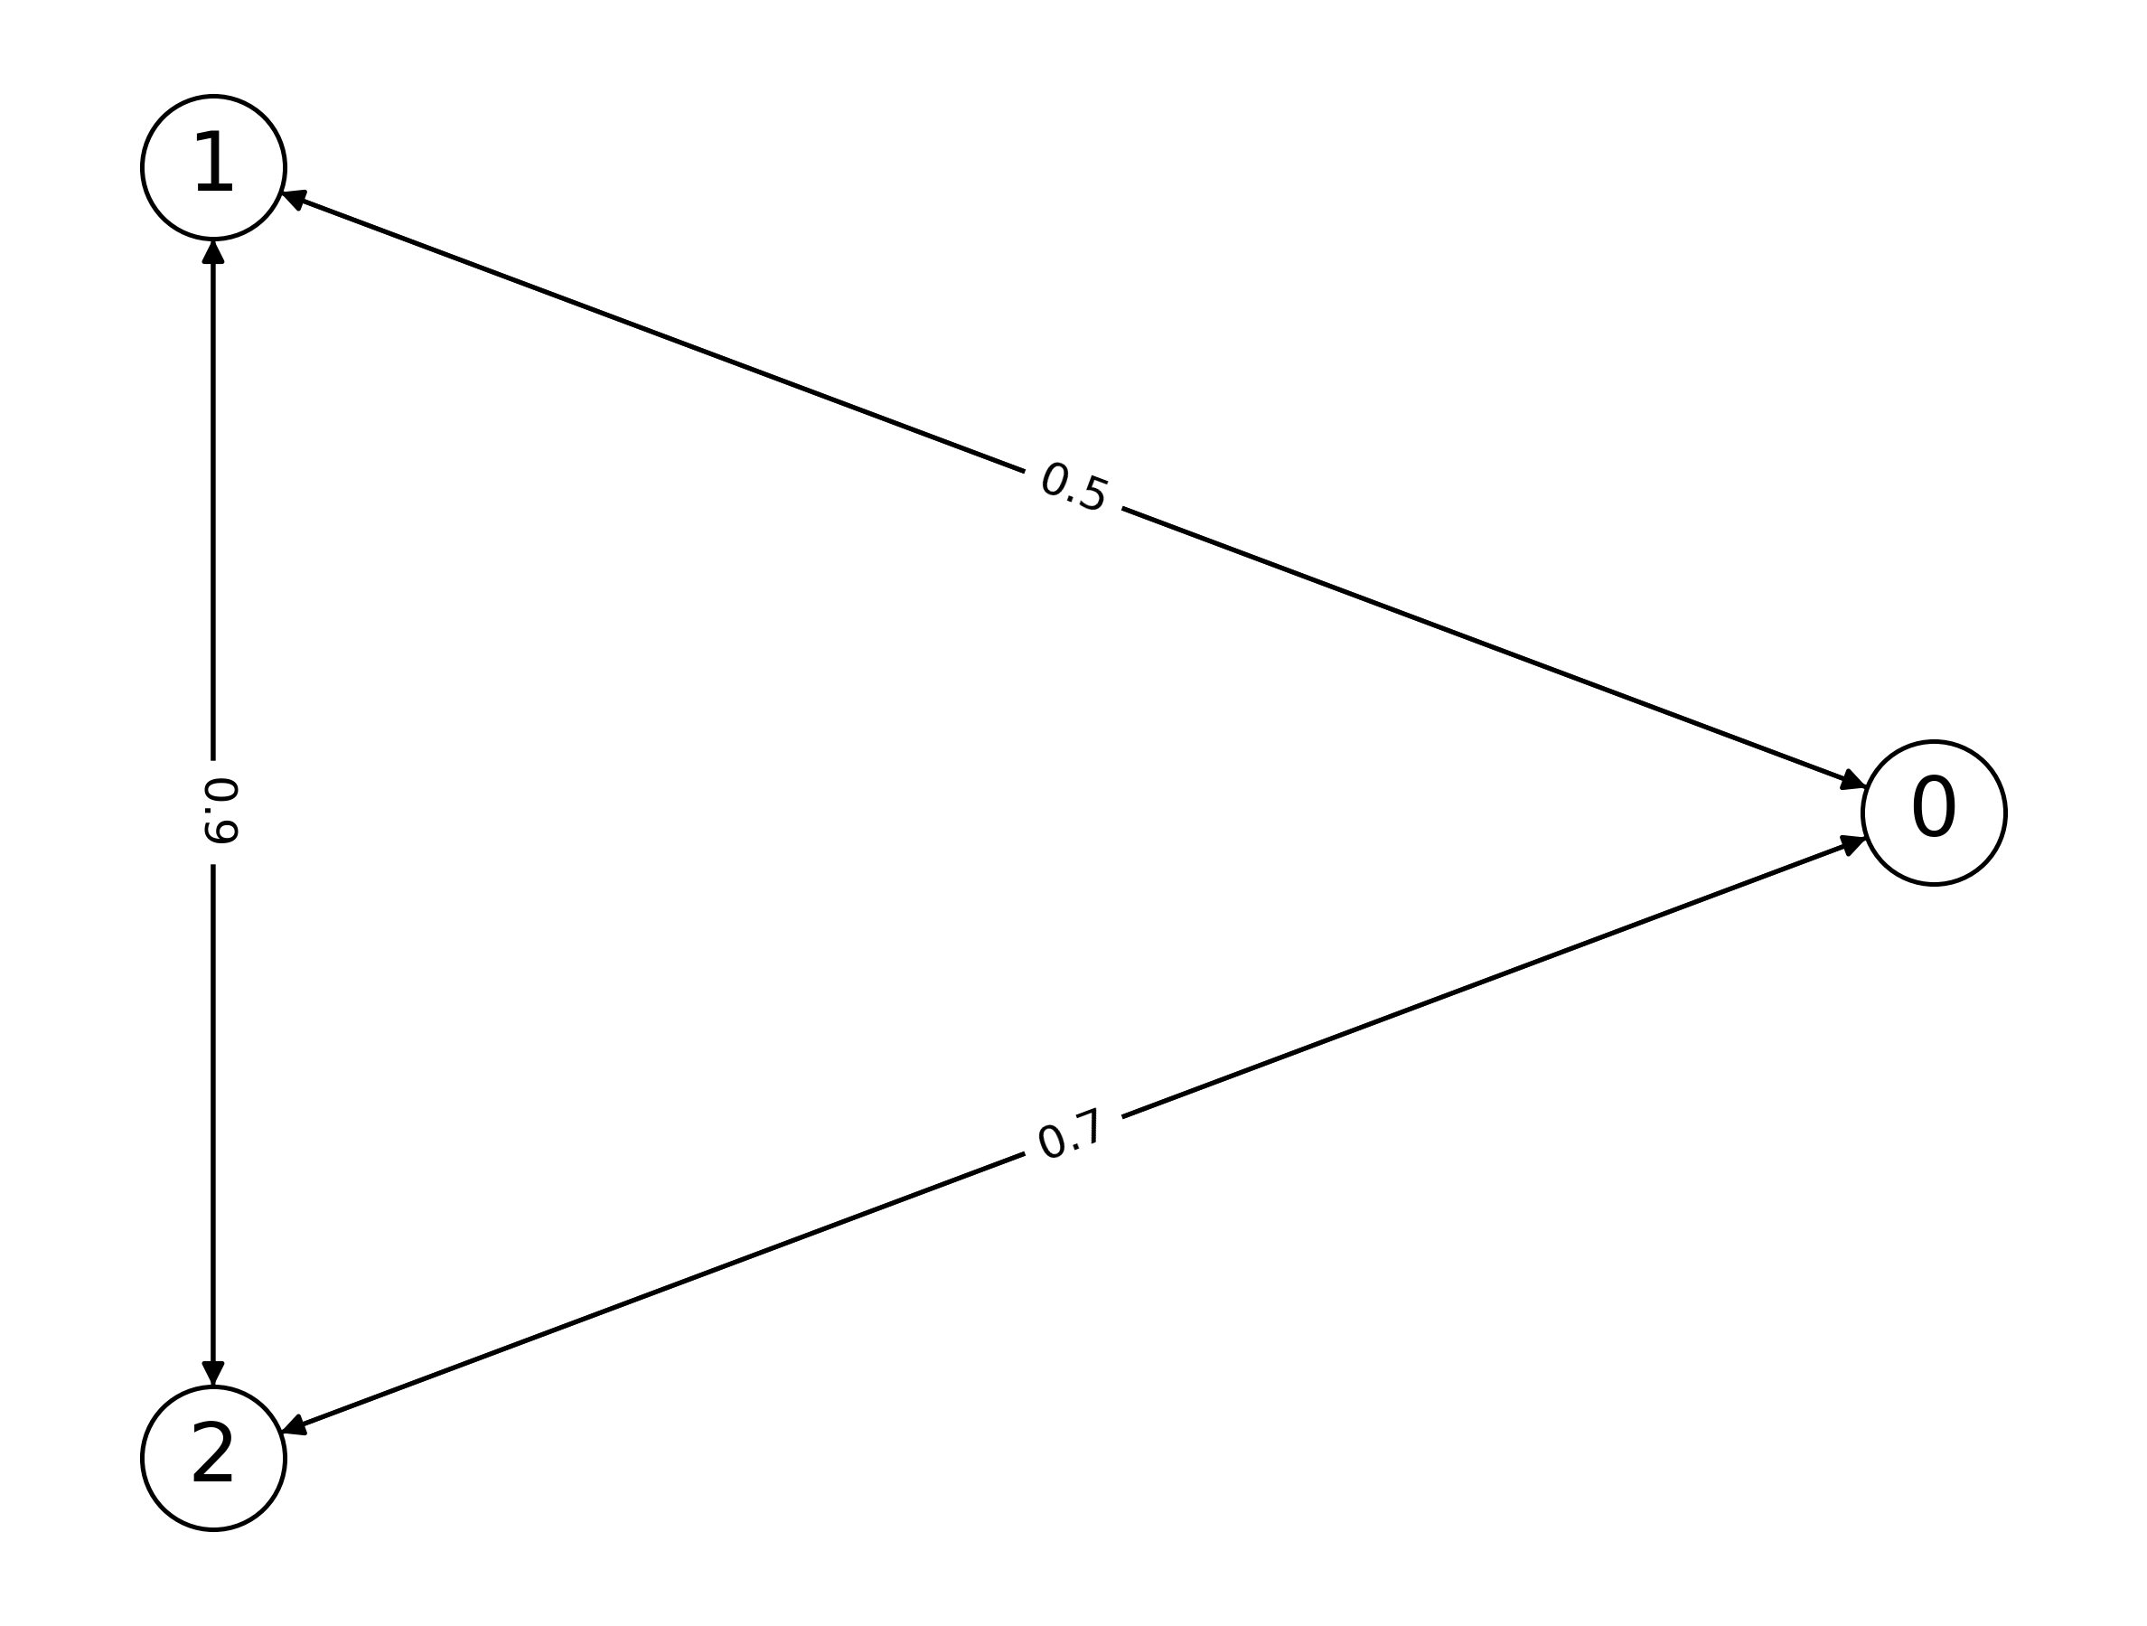
Seminario de astronomía – 27/11/2023
Directed graph (digraph): a graph in which edges have a direction, indicating a one-way relationship between nodes
Weighted graph: when edges are assigned some weights which represent cost, distance, etc.
V. Torres-Gomez
Galaxy stellar mass Estimation with Graph Neural Networks
Slide 1

Slide 26
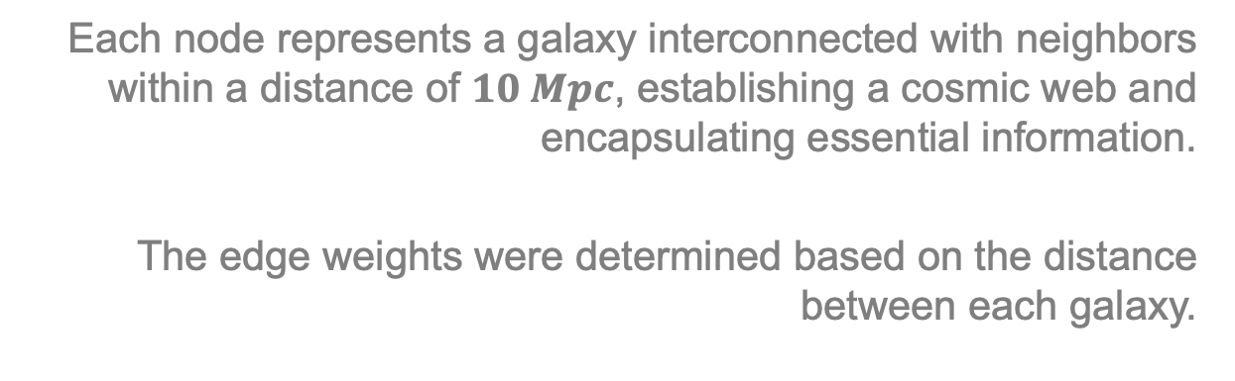
Seminario de astronomía – 27/11/2023
Our Galaxy graph
Each node represents a galaxy interconnected with neighbors within a distance of $10 Mpc$, establishing a cosmic web and encapsulating essential information.
The edge weights were determined based on the distance between each galaxy.
V. Torres-Gomez
Galaxy stellar mass Estimation with Graph Neural Networks
Slide 1

Slide 27
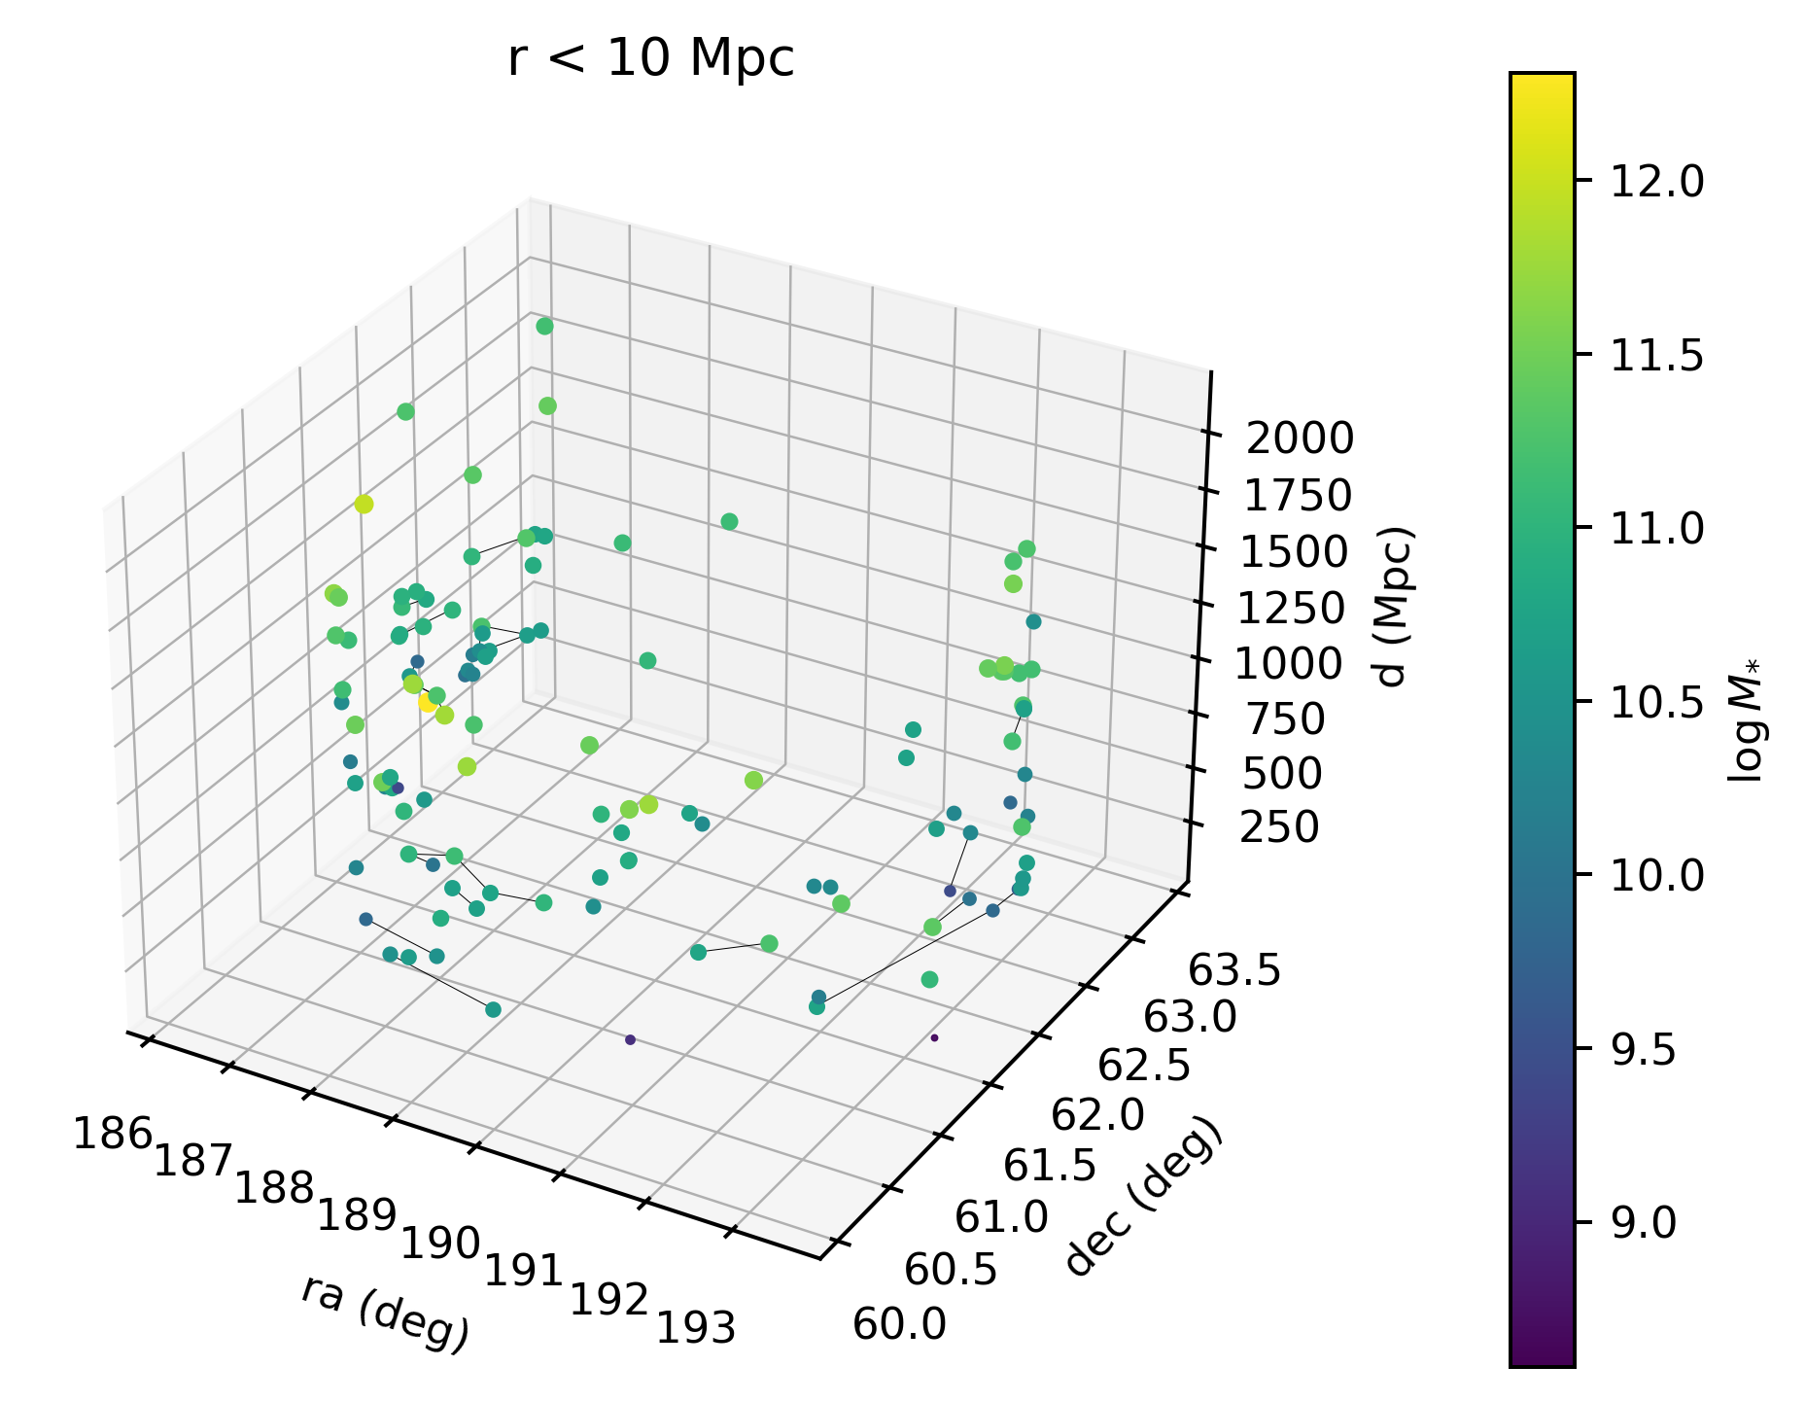
Seminario de astronomía – 27/11/2023
V. Torres-Gomez
Galaxy stellar mass Estimation with Graph Neural Networks
Slide 1

Slide 28
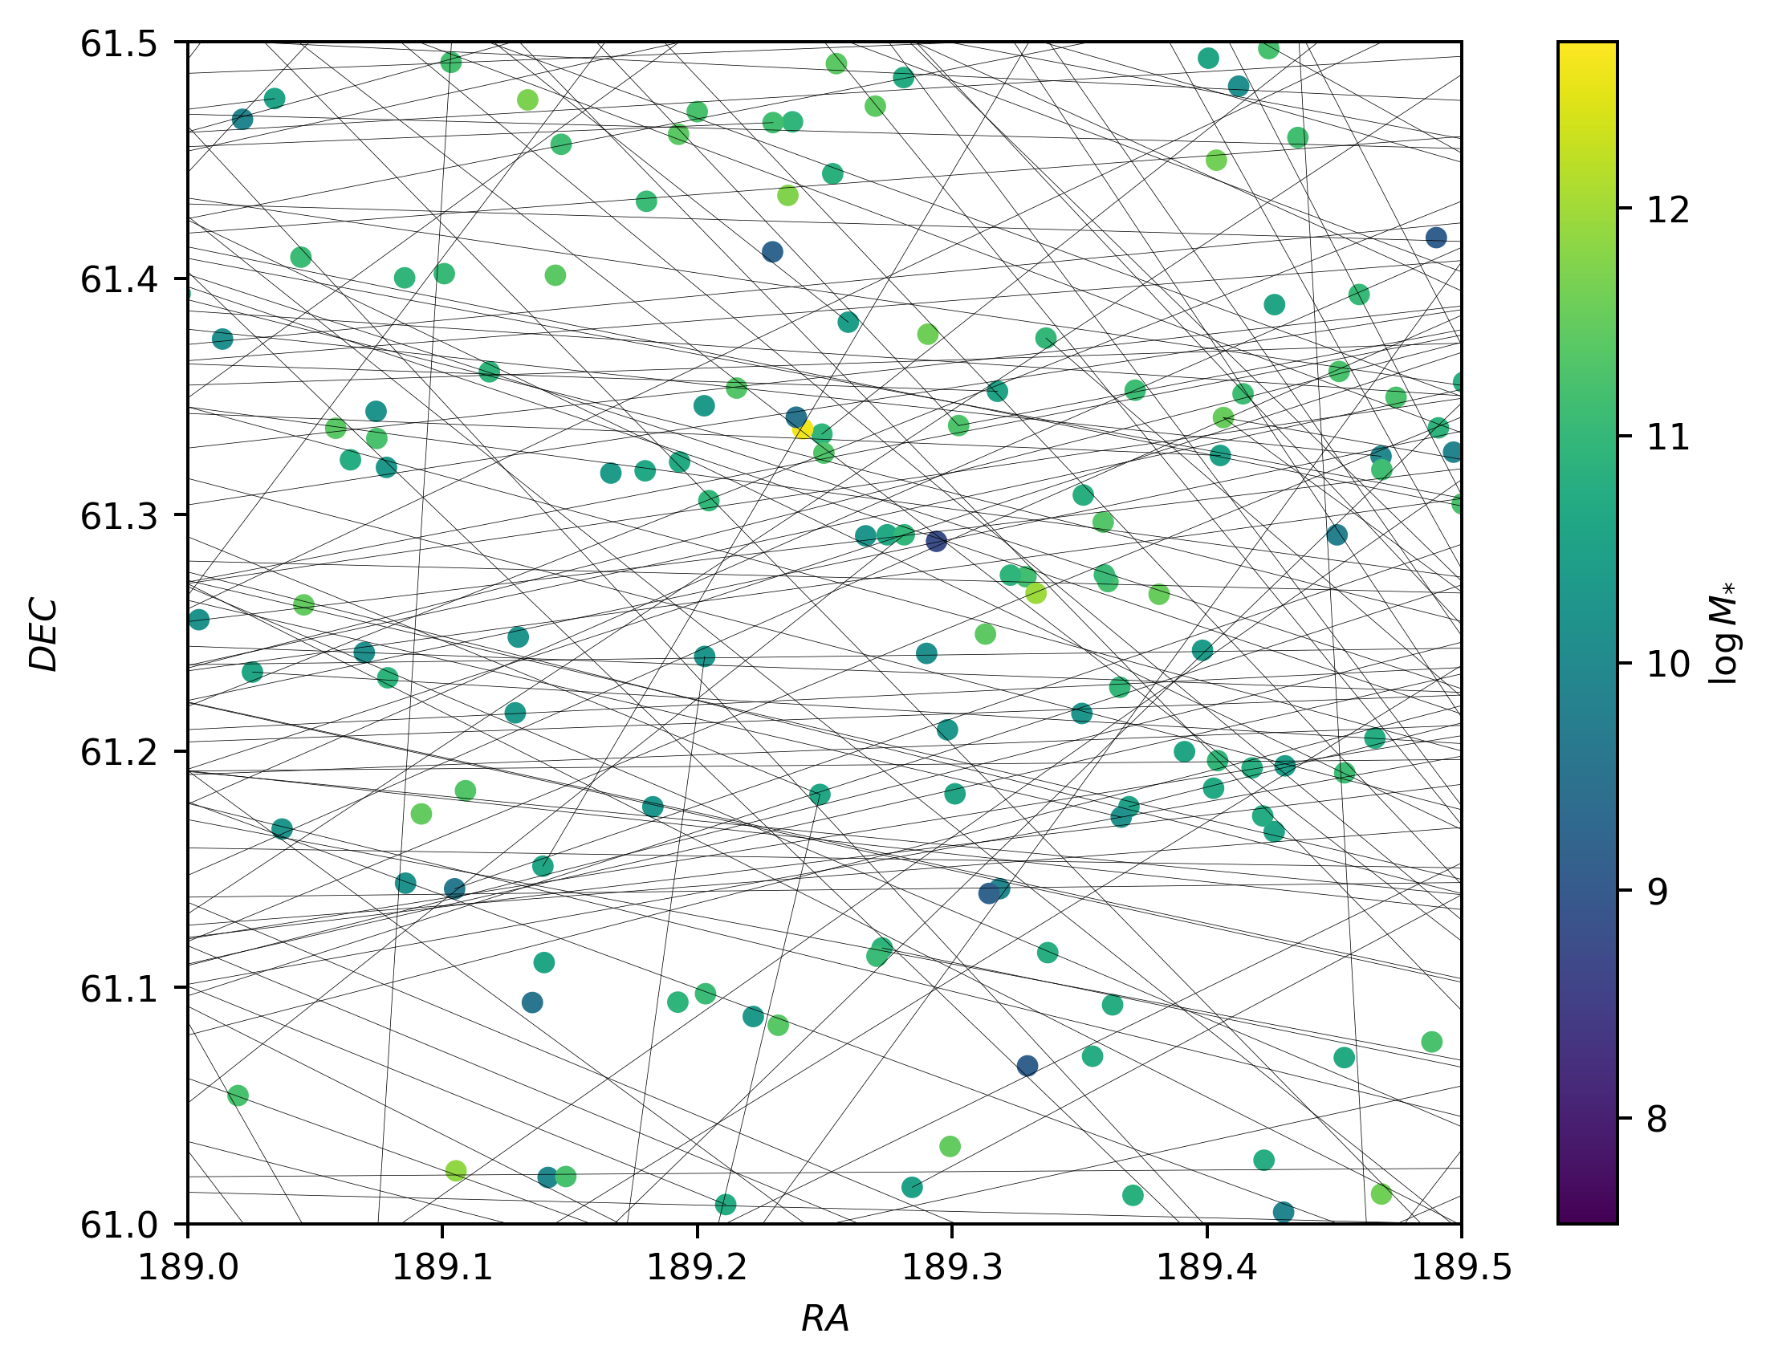
Seminario de astronomía – 27/11/2023
Average degree: 1.265
Max degree: 14
Mini degree: 0
Density: 0.00011
Has self-loops: False
Directed: False
V. Torres-Gomez
Galaxy stellar mass Estimation with Graph Neural Networks
Slide 1

Slide 29
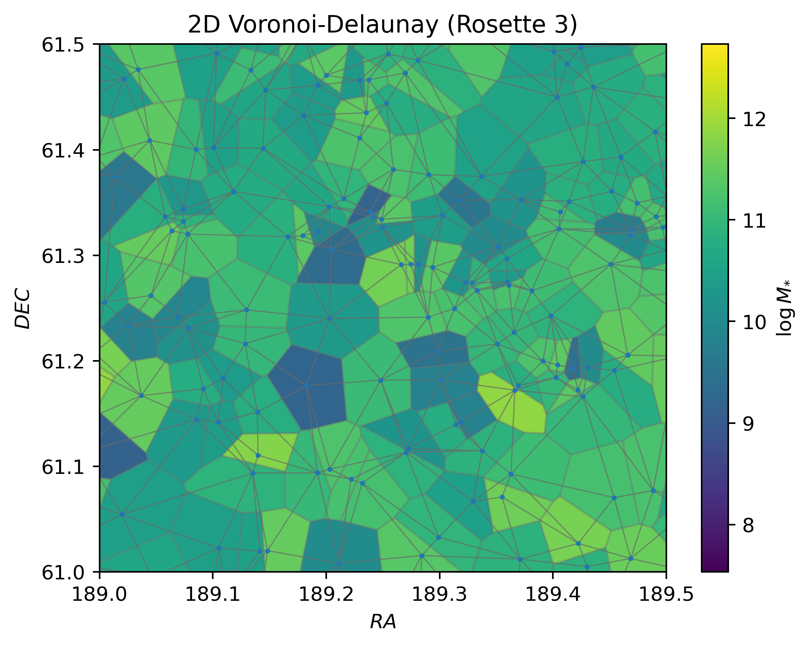
Seminario de astronomía – 27/11/2023
The Voronoi-Delaunay diagram shows the connectivity and density of galactic cells
V. Torres-Gomez
Galaxy stellar mass Estimation with Graph Neural Networks
Slide 1

Slide 30
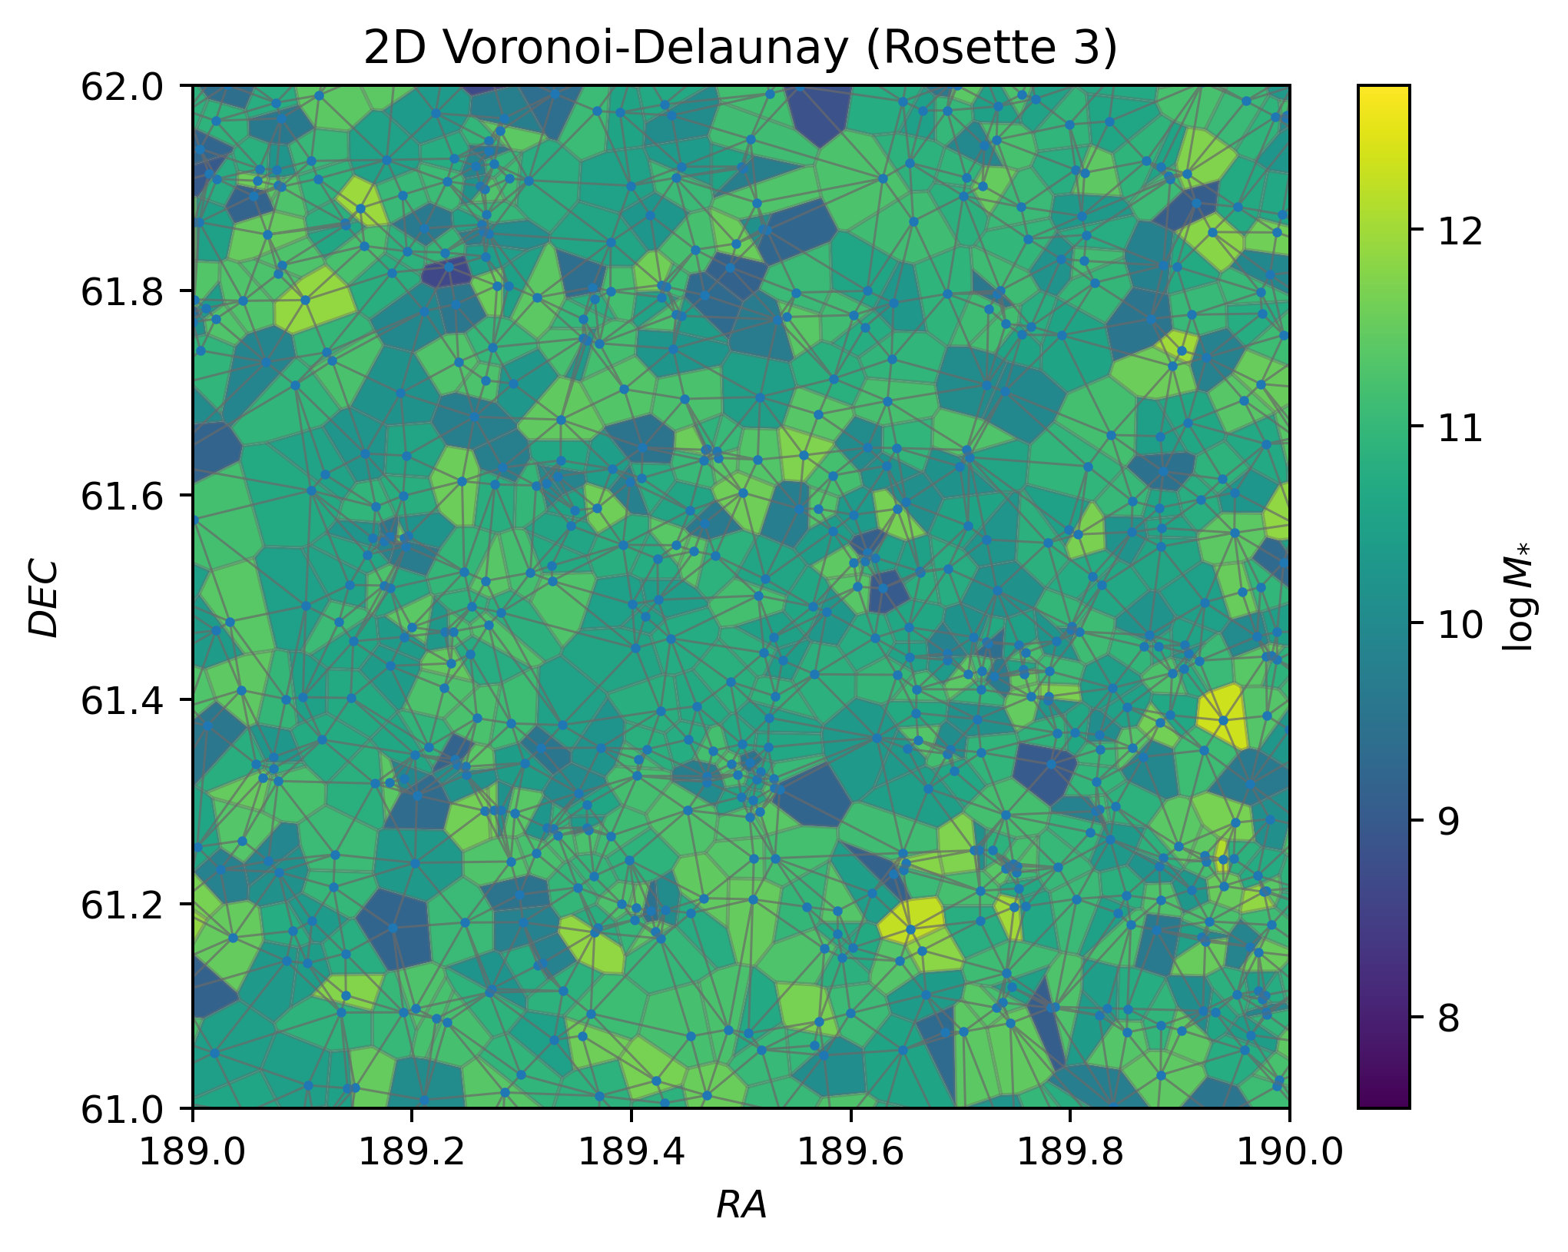
Seminario de astronomía – 27/11/2023
Regions of smaller Voronoi cells may imply higher galactic density, potentially indicating dense cosmic structures
V. Torres-Gomez
Galaxy stellar mass Estimation with Graph Neural Networks
Slide 1

Slide 31
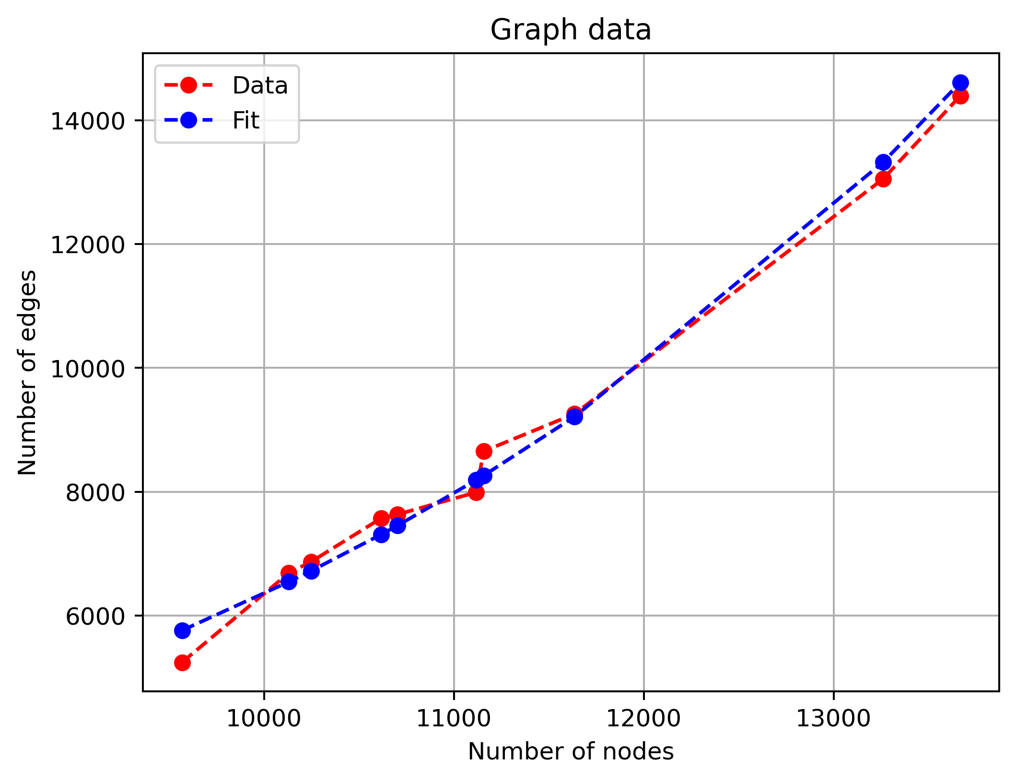
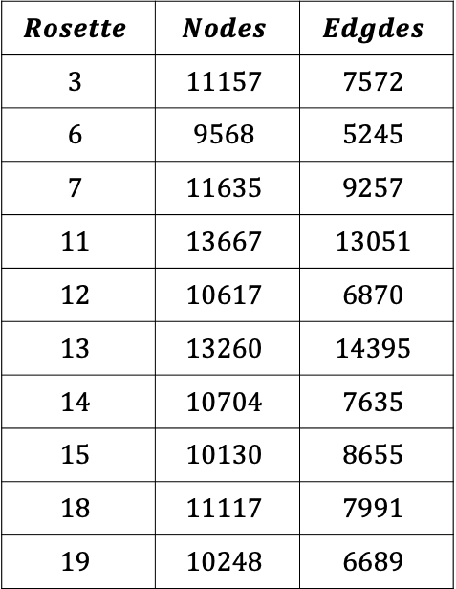
Seminario de astronomía – 27/11/2023
$$Rosette$$ | $$Nodes$$ | $$Edgdes$$
$$3$$ | $$11157$$ | $$7572$$
$$6$$ | $$9568$$ | $$5245$$
$$7$$ | $$11635$$ | $$9257$$
$$11$$ | $$13667$$ | $$13051$$
$$12$$ | $$10617$$ | $$6870$$
$$13$$ | $$13260$$ | $$14395$$
$$14$$ | $$10704$$ | $$7635$$
$$15$$ | $$10130$$ | $$8655$$
$$18$$ | $$11117$$ | $$7991$$
$$19$$ | $$10248$$ | $$6689$$
V. Torres-Gomez
Galaxy stellar mass Estimation with Graph Neural Networks
Slide 1

Slide 32
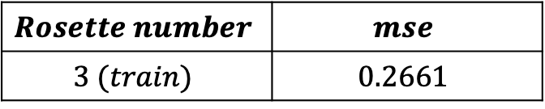
Seminario de astronomía – 27/11/2023
Our GNN model
Some training results on a pretty basic model
$$Rosette number$$ | $$mse$$
$$3 (train)$$ | $$0.2661$$
V. Torres-Gomez
Galaxy stellar mass Estimation with Graph Neural Networks
Slide 1

Slide 33
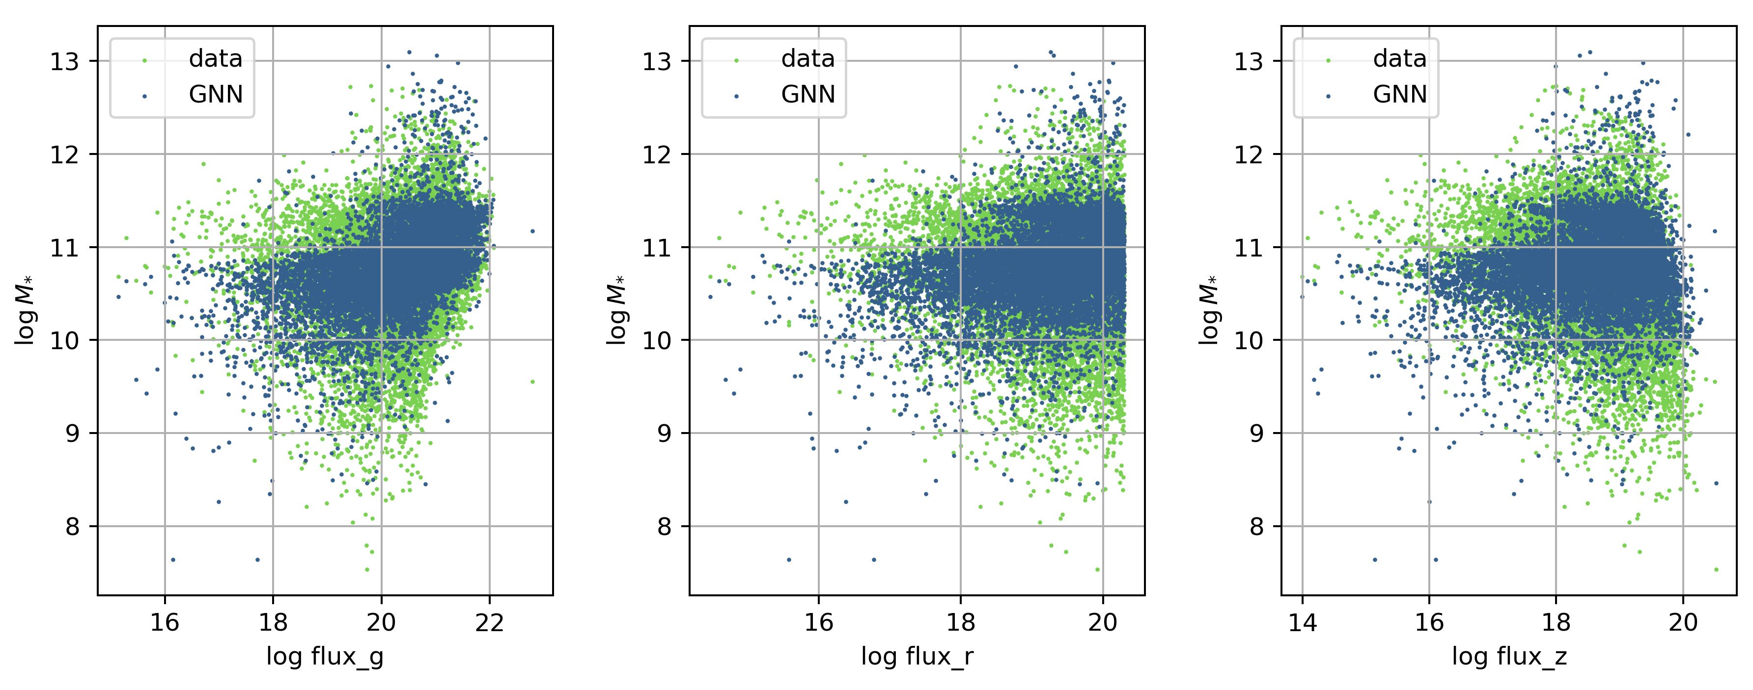
Seminario de astronomía – 27/11/2023
V. Torres-Gomez
Galaxy stellar mass Estimation with Graph Neural Networks
Slide 1

Slide 34
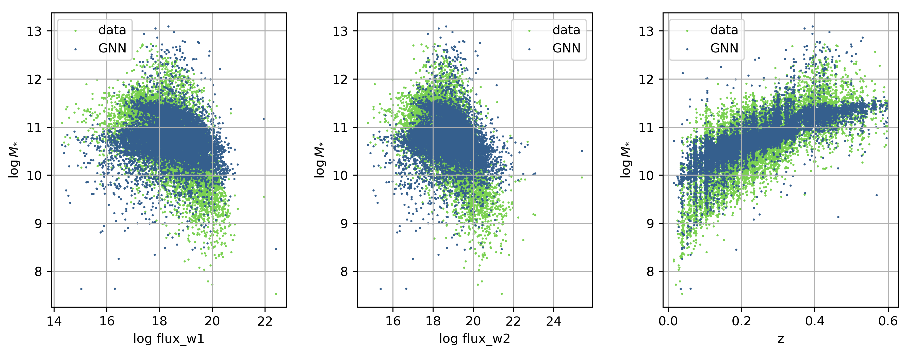
Seminario de astronomía – 27/11/2023
V. Torres-Gomez
Galaxy stellar mass Estimation with Graph Neural Networks
Slide 1

Slide 35
Seminario de astronomía – 27/11/2023
Conclussions
The success of the initial simple model has led to endeavors to enhance and develop a more robust neural network, with the aim of improving predictions to potentially surpass the performance of other models.
Our goal is to discern the effectiveness of the GNN model in harnessing spatial relationships encoded in cosmic graphs to enhance precision.
V. Torres-Gomez
Galaxy stellar mass Estimation with Graph Neural Networks
Slide 1

Slide 36
Seminario de astronomía – 27/11/2023
These findings set the stage for a comparative analysis between the Linear Regression, Random Forest, and Graph Neural Network models. Given the inherent graph structure of the galactic dataset, the GNN is anticipated to capture intricate relationships and patterns that may be overlooked by traditional models.
The forthcoming evaluation will center on exploring potentially novel graph-based metrics to assess the performance of predictive models for stellar mass estimation.
V. Torres-Gomez
Galaxy stellar mass Estimation with Graph Neural Networks
Slide 1

Slide 37
Seminario de astronomía – 27/11/2023
Adding a layer of novelty to this research is the utilization of observational data from DESI. In contrast to prior studies relying on simulated data, our approach delivers a more realistic and applicable estimation of stellar masses, providing a substantial advancement in the field of computational astrophysics
V. Torres-Gomez
Galaxy stellar mass Estimation with Graph Neural Networks
Slide 1

Slide 38
Seminario de astronomía – 27/11/2023
References
[1] DESI. (2023). DESI Data Early Data Release (EDR). https://data.desi.lbl.gov/doc/releases/edr/
[2] Pablo Villanueva-Domingo and Francisco Villaescusa-Navarro. Learning cosmology and clustering with cosmic graphs. The Astrophysical Journal, 937(2):115, October 2022. [3] Pedregosa et al. (2011). Scikit-learn: Machine Learning in Python. https://scikit-learn.org/stable/user_guide.html
[4] Wilson, R. (1996), Introduction to Graph Theory. https://www.maths.ed.ac.uk/~v1ranick/papers/wilsongraph.pdf
V. Torres-Gomez
Galaxy stellar mass Estimation with Graph Neural Networks
Slide 1

